Slide 1
Definition:-
Academic activity tracking system helps teachers to mark online attendance of students during class & reduce manual work. It is used to track student's attendance, absent record, assignment, question bank, exam, attendance history & other related documents.

Slide 2
purpose:-
Academic activity tracking system records and maintains student's attendance data using smart devices.
The system collects attendance records in the system and manages, stores and processes the data.
It generates daily attendance reports that help the faculty to track student's presence with high accuracy and efficiency.
If also generate assignment, question bank and exam.

Slide 3
Key features:-
For Admin:-
Maintain course, semester, subject etc.
Maintain lecture information
Get different types of attendance reports on one click
For Teacher:-
Maintain student attendance
Assignment Assign for students
Manage MCQ Question bank
Online MCQ exam
For Student:-
View Attendance
Detail Attendance
Submit Assignment
Submit MCQ Exam

Slide 4
Hardware Requirement:-
AMD RYZEN 3 3250U Processor
8.00 GB RAM
64-bit operating system, x64-based processor
Software requirement:-
Font End:-
HTML
CSS
JAVASCRIPT
PHP
Back End:-
MYSQL
Tools:-
Wampserver

Slide 5
modules:-
Admin Module:-
Admin can manage course.
Admin can manage semester.
Admin can manage subject.
Admin can manage teacher.
Admin can manage Allotment subject semester wise.
Admin can show different types of data.
Teacher Module:-
Teacher can manage Attendance like insert,update.
Teacher can manage lecture information.
Teacher can generate Assignment.
Teacher can generate question bank.
Student’s Module:-
Student’s can view attendance reports.
Student’s can submit assignment.
Student’s can give the exam online.

Slide 6
scope of project:-
Implementing secure login and role-based access for admin, teachers,Students.
When admin login is capable for handling all the web page information i.e., Course Entry Page, Semester Entry Page, Subject Entry Page, Lecturer Entry Page, Subject allotment Entry Page, Generate Roll number.
When lecturer login is capable for making entry of attendance of Students, manage the lectures information and manage the assignment and exam questions.
Objectives:-
Admin can handle all the web page easily to manage.
Teacher can easily manage attendance, assignment, exam for students.
Students can show the attendance, assignment and question bank.

Slide 7
Data Flow Diagram

Slide 8

$$ZERO LEVEL DFD :−$$
Academic
Activity
Tracking
System
ADMIN
LOGIN INFO
LOGIN INFO
TEACHER
ACCESS TO SYSTEM
ACCESS TO SYSTEM
ACCESS TO
SYSTEM
LOGIN
INFO
STUDENT

Slide 9

$1^{ST} LEVEL DFD:$-
STUDENT
Course
Semester
Subject
Registration
Lecture Info.
Que_bank
Exam
Teacher
Assignment
Subject Allotment
4.0
Manage
Lecture
Information
6.0
Manage
Question
Bank
1.0
Registration
Process
3.0
Master
Entry
Process
7.0
Manage
Exam
2.0
Login
Process
5.0
Manage
Assignment
8.0
Student
Activity
10.0
Report
9.0
Profile
Lecture info.
Assignment
Exam
ADMIN
TEACHER

Slide 10
$$2^{nd} LEVEL DFD for 3.0 \left(Master Entry Process\right):−$$
3.1
MANAGE
COURSE
COURSE INFO
COURSE INFO
COURSE DETAIL
COURSE DETAIL
COURSE DETAIL
SEMESTER INFO
3.2
MANAGE
SEMEST-ER
SEMESTER INFO
SEMESTER DETAIL
SEMESTER DETAIL
SEMESTER DETAIL
ADMIN
SUBJECT INFO
3.3
MANAGE
SUBJECT
SUBJECT INFO
SUBJECT DETAIL
SUBJECT DETAIL
SUBJECT DETAIL
TEACHER INFO
3.4
MANAGE
TEACH-ER
TEACHER INFO
TEACHER DETAIL
TEACHER DETAIL
TEACHER DETAIL
SUBJECT ALLOTMENT INFO
3.5
MANAGE
SUBJECT
ALLOT-MENT
SUBJECT ALLOTMENT INFO
SUBJECT ALLOTMENT DETAIL
SUBJECT ALLOTMENT DETAIL
SUBJECT ALLOTMENT DETAIL

Slide 11
$$2^{nd} LEVEL DFD for 4.0\left(Manage Lecture Informaton\right):−$$
LECTURE INFORMANTION INFO
4.1
INSERT
LECTURE INFORMAN-TION
DETAIL
LECTURE INFORMANTION INFO
LECTURE INFORMANTION DETAIL
LECTURE INFORMANTION DETAIL
4.2
UPDATE
LECTURE INFORMAN-TION
DETAIL
LECTURE INFORMANTION INFO
LECTURE INFORMANTION INFO
LECTURE INFORMANTION DETAIL
ADMIN
LECTURE INFORMANTION DETAIL
LECTURE
INFORMANTION DETAIL
LECTURE INFORMANTION INFO
4.3
DELETE
LECTURE INFORMAN-TION
DETAIL
LECTURE INFORMANTION INFO
LECTURE INFORMANTION DETAIL
LECTURE INFORMANTION DETAIL

Slide 12
$$2^{nd} LEVEL DFD for 5.0\left(Manage Assignment\right):−$$
ASSIGNMENT INFO
6.1
CREATE
ASSIGNMENT
ASSIGNMENT INFO
ASSIGNMENT DETAIL
ASSIGNMENT DETAIL
ASSIGNMENT INFO
6.2
UPDATE
ASSIGNMENT
ASSIGNMENT INFO
TEACHER
ASSIGNMENT DETAIL
ASSIGNMENT
DETAIL
ASSIGNMENT DETAIL
ASSIGNMENT INFO
6.3
DELETE
ASSIGNMENT
ASSIGNMENT INFO
ASSIGNMENT DETAIL
ASSIGNMENT DETAIL

Slide 13
$$2^{nd} LEVEL DFD for 6.0\left(Manage Question\right):−$$
QUESTION INFO
6.1
ADD
QUESTION
QUESTION INFO
QUESTION DETAIL
QUESTION DETAIL
QUESTION INFO
6.2
UPDATE
QUESTION
QUESTION INFO
TEACHER
QUESTION
DETAIL
QUESTION DETAIL
QUESTION DETAIL
QUESTION INFO
6.3
DELETE
QUESTION
QUESTION INFO
QUESTION DETAIL
QUESTION DETAIL

Slide 14
$$2^{nd} LEVEL DFD for 7.0\left(Manage Exam\right):−$$
EXAM INFO
7.1
CREATE
EXAM
EXAM INFO
EXAM DETAIL
EXAM DETAIL
3.3.2
UPDATE
EXAM
TEACHER
EXAM DETAIL
EXAM INFO
7.2
DECLARE
EXAM
EXAM INFO
EXAM DETAIL
EXAM DETAIL

Slide 15
$$2^{nd} LEVEL DFD for 8.0\left(Student Activity\right):−$$
ATTENDANCE INFO
8.1
View
Attendance
ATTENDANCE
INFO
LECTURE INFORMATION
DETAIL
ATTENDANCE
DETAIL
ATTENDANCE DETAIL
ASSIGNMENT
INFO
8.2
ASSIGNMENT
SUBMISSION
ASSIGNMENT
INFO
ASSIGNMENT
DETAIL
STUDENT
ASSIGNMENT
DETAIL
ASSIGNMENT
DETAIL
EXAM INFO
8.3
APPEAR
EXAM
EXAM
DETAIL
EXAM INFO
EXAM DETAIL
EXAM DETAIL

Slide 16
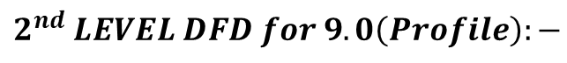
$$2^{nd} LEVEL DFD for 9.0\left(Profile\right):−$$
PROFILE INFO
9.1
INSERT
PROFILE
DETAIL
PROFILE INFO
PROFILE DETAIL
PROFILE DETAIL
PROFILE INFO
9.2
UPDATE
PROFILE
DETAIL
PROFILE INFO
ADMIN/
TEACHER
PROFILE DETAIL
PROFILE DETAIL
PROFILE DETAIL
PROFILE INFO
9.3
DELETE
PROFILE
DETAIL
PROFILE INFO
PROFILE DETAIL
PROFILE DETAIL

Slide 17
$$3^{rd} LEVEL DFD for 3.1\left(Manage Course\right):−$$
COURSE INFO
3.1.1
INSERT
COURSE
DETAIL
COURSE INFO
COURSE DETAIL
COURSE DETAIL
COURSE INFO
3.1.2
UPDATE
COURSE
DETAIL
COURSE INFO
COURSE DETAIL
ADMIN
COURSE DETAIL
COURSE DETAIL
COURSE INFO
3.1.3
DELETE
COURSE
DETAIL
COURSE INFO
COURSE DETAIL
COURSE DETAIL

Slide 18
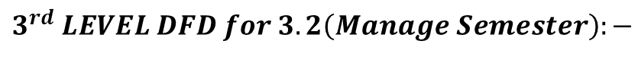
$$3^{rd} LEVEL DFD for 3.2\left(Manage Semester\right):−$$
SEMESTER INFO
3.2.1
INSERT
SEMES-TER
DETAIL
SEMESTER INFO
SEMESTER DETAIL
SEMESTER DETAIL
SEMESTER INFO
3.2.2
UPDATE
SEMES-TER
DETAIL
SEMESTER INFO
SEMESTER DETAIL
ADMIN
SEMESTER DETAIL
SEMESTER DETAIL
SEMESTER INFO
3.2.3
DELETE
SEMES-TER
DETAIL
SEMESTER INFO
SEMESTER DETAIL
SEMESTER DETAIL

Slide 19
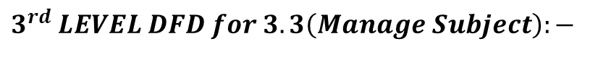
$$3^{rd} LEVEL DFD for 3.3\left(Manage Subject\right):−$$
SUBJECT INFO
3.3.1
INSERT
SUBJECT
DETAIL
SUBJECT INFO
SUBJECT DETAIL
SUBJECT DETAIL
SUBJECT INFO
3.3.2
UPDATE
SUBJECT
DETAIL
SUBJECT INFO
SUBJECT DETAIL
ADMIN
SUBJECT DETAIL
SUBJECT DETAIL
SUBJECT INFO
3.3.3
DELETE
SUBJECT
DETAIL
SUBJECT INFO
SUBJECT DETAIL
SUBJECT DETAIL

Slide 20
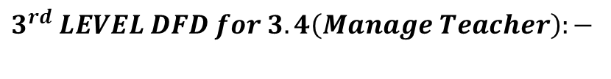
$$3^{rd} LEVEL DFD for 3.4\left(Manage Teacher\right):−$$
TEACHER INFO
3.4.1
INSERT
TEACH-ER
DETAIL
TEACHER INFO
TEACHER DETAIL
TEACHER DETAIL
TEACHER INFO
3.4.2
UPDATE
TEACH-ER
DETAIL
TEACHER INFO
TEACHER DETAIL
ADMIN
TEACHER DETAIL
TEACHER DETAIL
TEACHER INFO
3.4.3
DELETE
TEACH-ER
DETAIL
TEACHER INFO
TEACHER DETAIL
TEACHER DETAIL

Slide 21
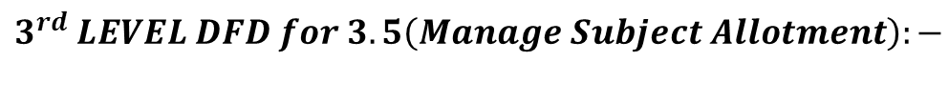
$$3^{rd} LEVEL DFD for 3.5\left(Manage Subject Allotment\right):−$$
SUBJECT ALLOTMENT INFO
3.5.1
INSERT
SUBJECT ALLOTMENT
DETAIL
SUBJECT ALLOTMENT INFO
SUBJECT ALLOTMENT DETAIL
SUBJECT ALLOTMENT DETAIL
SUBJECT ALLOTMENT INFO
3.5.2
UPDATE
SUBJECT ALLOTMENT
DETAIL
SUBJECT ALLOTMENT INFO
SUBJECT ALLOTMENT DETAIL
ADMIN
SUBJECT ALLOTMENT DETAIL
SUBJECT
ALLOTMENT DETAIL
SUBJECT ALLOTMENT INFO
3.5.3
DELETE
SUBJECT ALLOTMENT
DETAIL
SUBJECT ALLOTMENT INFO
SUBJECT ALLOTMENT DETAIL
SUBJECT ALLOTMENT DETAIL

Slide 22
ER Diagram

Slide 23
fname
T_ID
Take
Lecture
Designation
Take
Attendance
Attendance
Email
Have
Password
Subject
Sub_ID
Teacher
Lect_id
S_id
P_flag
Sem_ID
Allotment
Course_ID
Sub_Code
Sem_ID
Sem_Name
Sub_Name
Appoint
Semester
Course_ID
Assign
Lec_ID
que_id
course_id
course_id
assign_
id
Sem_ID
Create
e_id
course_id
sem_id
Has
Sub_ID
Exam
sem_id
Assignment
Lec_method
Question Bank
Appear
sub_id
sub_id
Add
Add
Lecture
exam_date
sem_id
assign_
topic
t_id
gender
S_ID
ans
S_fn
Lectopic
email
Have
que
Student
t_id
t_id
password
sub_id
dob
Submit
Course_name
Have
Add
contact
Course_ID
Enroll-
ment
Admin
Course
Add
Attend
Course_sem
Password
Course_type
Email
Add

Slide 24
Login details:-
File name | Data type | Length | Constraint | Null | Description
Userid | Int | 10 | - | Not Null | Username
password | Varchar | 20 | - | Not Null | Password

Slide 25
Course Details:-
File name | Data type | Length | Constraint | Null | Description
course_id | Int | 3 | Primary key | Not null | Auto increment
course_name | Varchar | 50 | - | Not null | Course name
course_type | Varchar | 10 | - | Not null | Course type
course_sem | Varchar | 10 | - | Not null | Course wise Number of semester

Slide 26
Semester details:-
File name | Data type | Length | Constraint | Null | Description
sem_id | Int | 3 | Primary Key | Not Null | Auto increment
sem_name | Varchar | 20 | - | Not Null | Semester name

Slide 27
Subject details:-
File name | Data type | Length | Constraint | Null | Description
sub_id | int | 3 | Primary Key | Not Null | Auto increment
course_id | int | 3 | Foreign Key | Not Null | Refrence from course
sem_id | int | 3 | Foreign Key | Not Null | Refrence from semester
sub_code | Varchar | 20 | - | Not Null | Subject code
sub_name | Varchar | 40 | - | Not Null | Subject name

Slide 28
Designation:-
File name | Data type | Length | Constraint | Null | Description
des_id | Int | 3 | Primary Key | Not Null | Auto increment
des_name | Varchar | 20 | - | Not Null | Designation name

Slide 29
Teacher:-
File name | Data type | Length | Constraint | Null | Description
t_id | Int | 3 | Primary Key | Not Null | Auto increment
u_type | Varchar | 20 | - | Not Null | Admin or teacher
fname | Varchar | 40 | - | Not Null | First name
mname | Varchar | 40 | - | Not Null | Middle name
lname | Varchar | 40 | - | Not Null | Last name
gender | Varchar | 20 | - | Not Null | Gender
dob | Date |  | - | Not Null | Date of Birth
qulification | Varchar | 40 | - | Not Null | Qulification
des_id | Varchar | 40 | Foreign Key | Not Null | Reference from designation
doj | Date |  | - | Not Null | Date of join
contact | Varchar | 10 | - | Not Null | Contact
email | Varchar | 40 | - | Not Null | Email
password | Varchar | 40 | - | Not Null | Password

Slide 30
Subject allotment:-
File name | Data type | Length | Constraint | Null | Description
sa_id | Int | 3 | Primary Key | Not Null | Auto increment
course_id | Int | 3 | Foreign Key | Not Null | Course table
sem_id | Int | 3 | Foreign Key | Not Null | Semester table
sub_id | Int | 3 | Foreign Key | Not Null | Subject table
t_id | Int | 3 | Foreign Key | Not Null | Teacher table
academic_year | Varchar | 20 | - | Not Null | Academic year

Slide 31
Lecture information:-
File name | Data type | Length | Constraint | Null | Description
lec_id | Int | 3 | Primary Key | Not Null | Auto increment
lec_date | Date |  | - | Not Null | Lecture of date
course_id | Int | 3 | Foreign Key | Not Null | Course table
sem_id | Int | 3 | Foreign Key | Not Null | Semester table
lec_no | Int | 20 | - | Not Null | Lecture of number
po_status | Varchar | 30 | - | Not Null | Proxy lecture or not
sub_id | Int | 3 | Foreign Key | Not Null | Subject table
t_id | Int | 3 | Foreign Key | Not Null | Teacher table
lec_topic | Varchar | 50 | - | Not Null | Topic of lecture
lec_method | varchar | 50 | - | Not Null | Method of lecture

Slide 32
Students attendance:-
File name | Data type | Length | Constraint | Null | Description
lec_id | Int | 3 | Foreign Key | Not Null | Lecture information table
s_id | Int | 3 | Foreign Key | Not Null | Student table
p_flag | Varchar | 1 | - | Not Null | Present and Absent

Slide 33
Students restration:-
File name | Data type | Length | Constraint | Null | Description
s_id | Int | 3 | Primary Key | Not Null | Auto increment
s_fn | Varchar | 20 | - | Not Null | Student First Name
s_mn | Varchar | 40 | - | Not Null | Student Middle Name
s_ln | Varchar | 20 | - | Not Null | Student Last Name
dob | Date |  | - | Not Null | Date of birth
gender | Varchar | 10 | - | Not Null | Gender
address | Varchar | 50 | - | Not Null | Address
gr_no | Varchar | 10 | - | Not Null | General register number
en_no | Varchar | 10 | - | Not Null | Enrollment number
contact | Varchar | 10 | - | Not Null | Contact
parents_contact | Varchar | 10 | - | Not Null | Parents contact
email | Varchar | 40 | - | Not Null | Email
password | Varchar | 40 | - | Not Null | Password
roll_no | Int | 5 | - | Not Null | Roll number
approval_status | Boolean |  | - | Not Null | Approval Status
course _id | Int | 3 | Foreign Key | Not Null | Course Table
sem_id | Int | 3 | Foreign Key | Not Null | Semester Table

Slide 34
assignment:-
File name | Data type | Length | Constraint | Null | Description
assign_id | Int | 3 | Primary Key | Not Null | Auto increment
course_id | Int | 3 | Foreign Key | Not Null | Course table
sem_id | Int | 3 | Foreign Key | Not Null | Semester table
sub_id | Int | 3 | Foreign Key | Not Null | Subject table
assign_date | Date | - | - | Not Null | Assignment date
submi_date | Date | - | - | Not Null | Submission date
assign_topic | Varchar | 300 | - | Not Null | Assignment topic
t_id | Int | 3 | Foreign Key | Not Null | Teacher table

Slide 35
Exam:-
File name | Data type | Length | Constraint | Null | Description
e_id | Int | 3 | Primary Key | Not Null | Auto increment
course_id | Int | 3 | Foreign Key | Not Null | Course table
sem_id | Int | 3 | Foreign Key | Not Null | Semester table
sub_id | Int | 3 | Foreign Key | Not Null | Subject table
date | Date | - | - | Not Null | Exam date

Slide 36
Question:-
File name | Data type | Length | Constraint | Null | Description
que_id | Int | 3 | Primary Key | Not Null | Auto increment
course_id | Int | 3 | Foreign Key | Not Null | Course table
sem_id | Int | 3 | Foreign Key | Not Null | Semester table
sub_id | Int | 3 | Foreign Key | Not Null | Subject table
que | Varchar | 100 | - | Not Null | Question
oa | Varchar | 50 | - | Not Null | Option A
ob | Varchar | 50 | - | Not Null | Option B
oc | Varchar | 50 | - | Not Null | Option C
od | Varchar | 50 | - | Not Null | Option D
ans | Varchar | 50 | - | Not Null | Answer
t_id | Int | 3 | Foreign Key | Not Null | Teacher table

Slide 37
Student submission:-
File name | Data type | Length | Constraint | Null | Description
as_id | Int | 3 | Primary Key | Not Null | Auto increment
assign_id | Int | 3 | Foreign Key | Not Null | Assignment id
s_id | Int | 3 | Foreign Key | Not Null | Student id
sub_date | Date |  | - | Not Null | Submission date
assignment_file | Varchar | 50 | - | Not Null | Assignment file (pdf)
marks | Int | 3 | - | Not Null | Marks

Slide 38
Admin Side

Slide 39
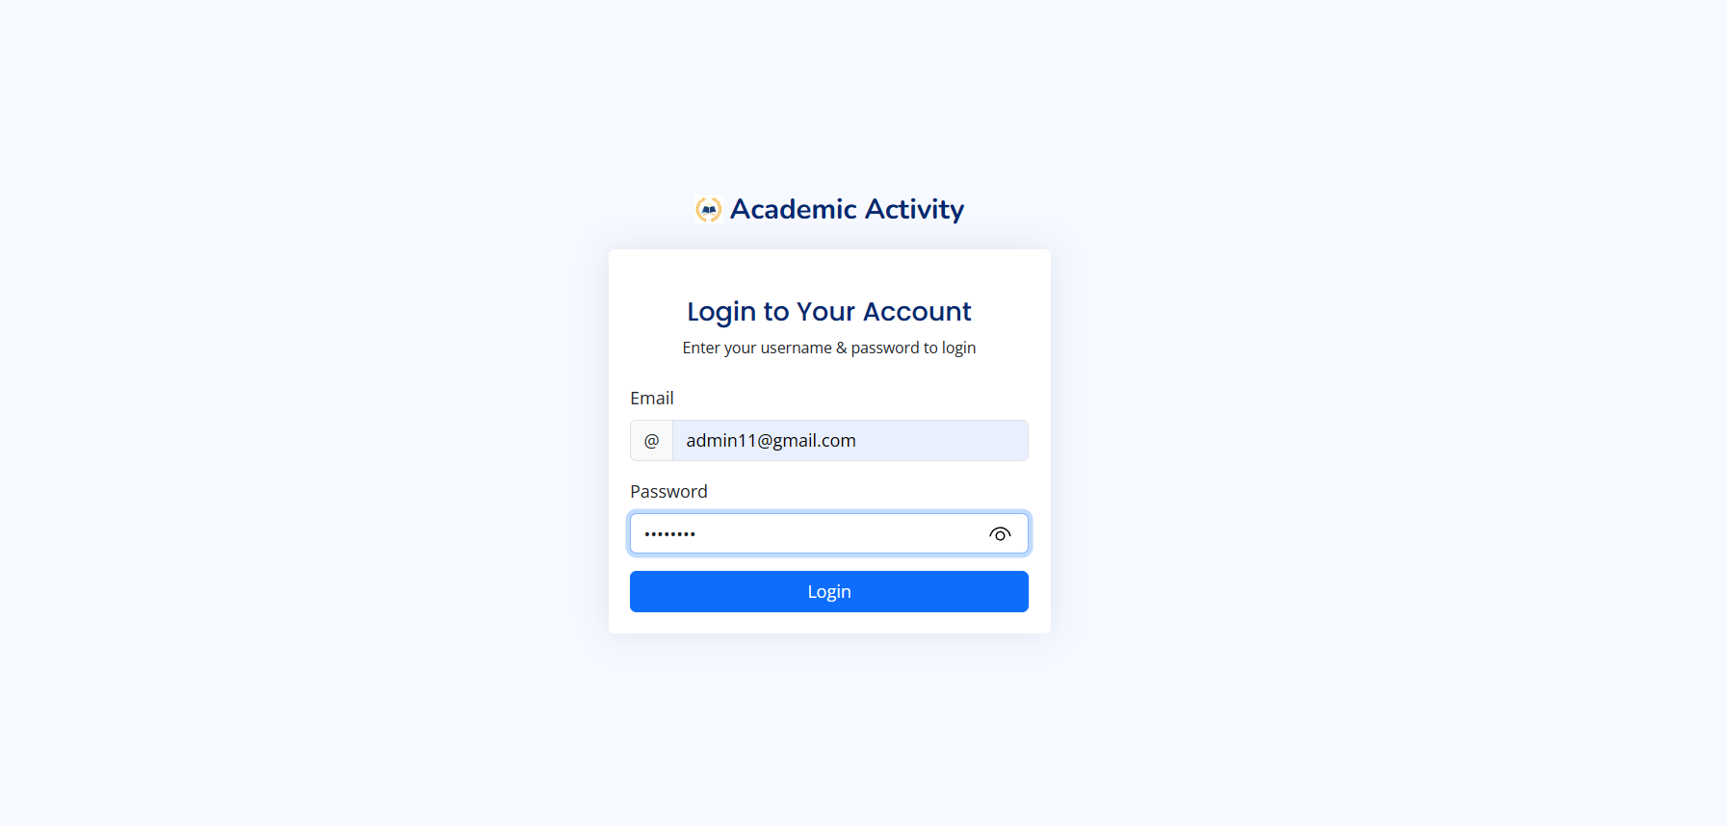

Slide 40
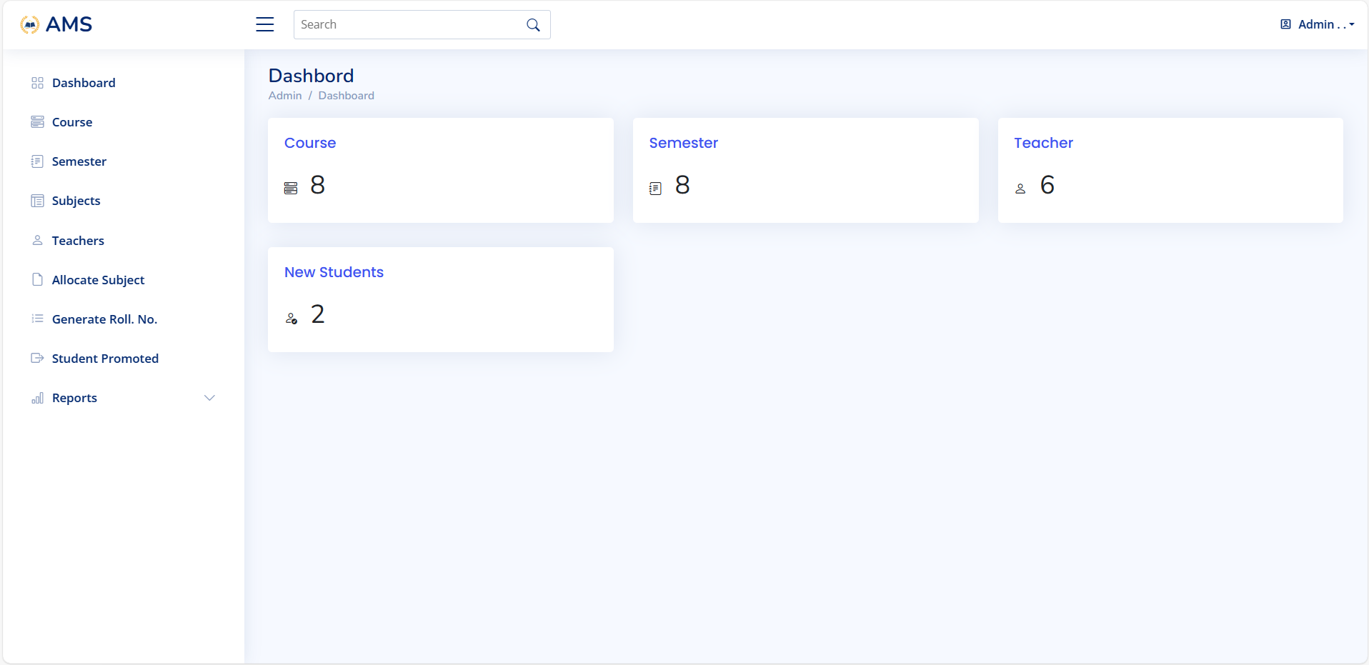

Slide 41
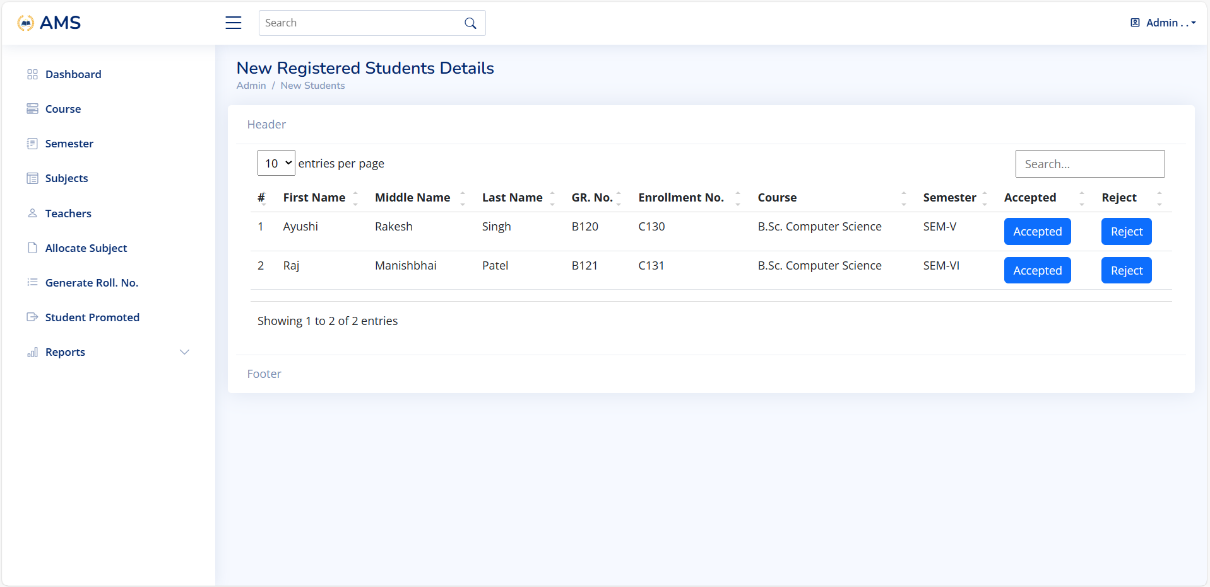

Slide 42
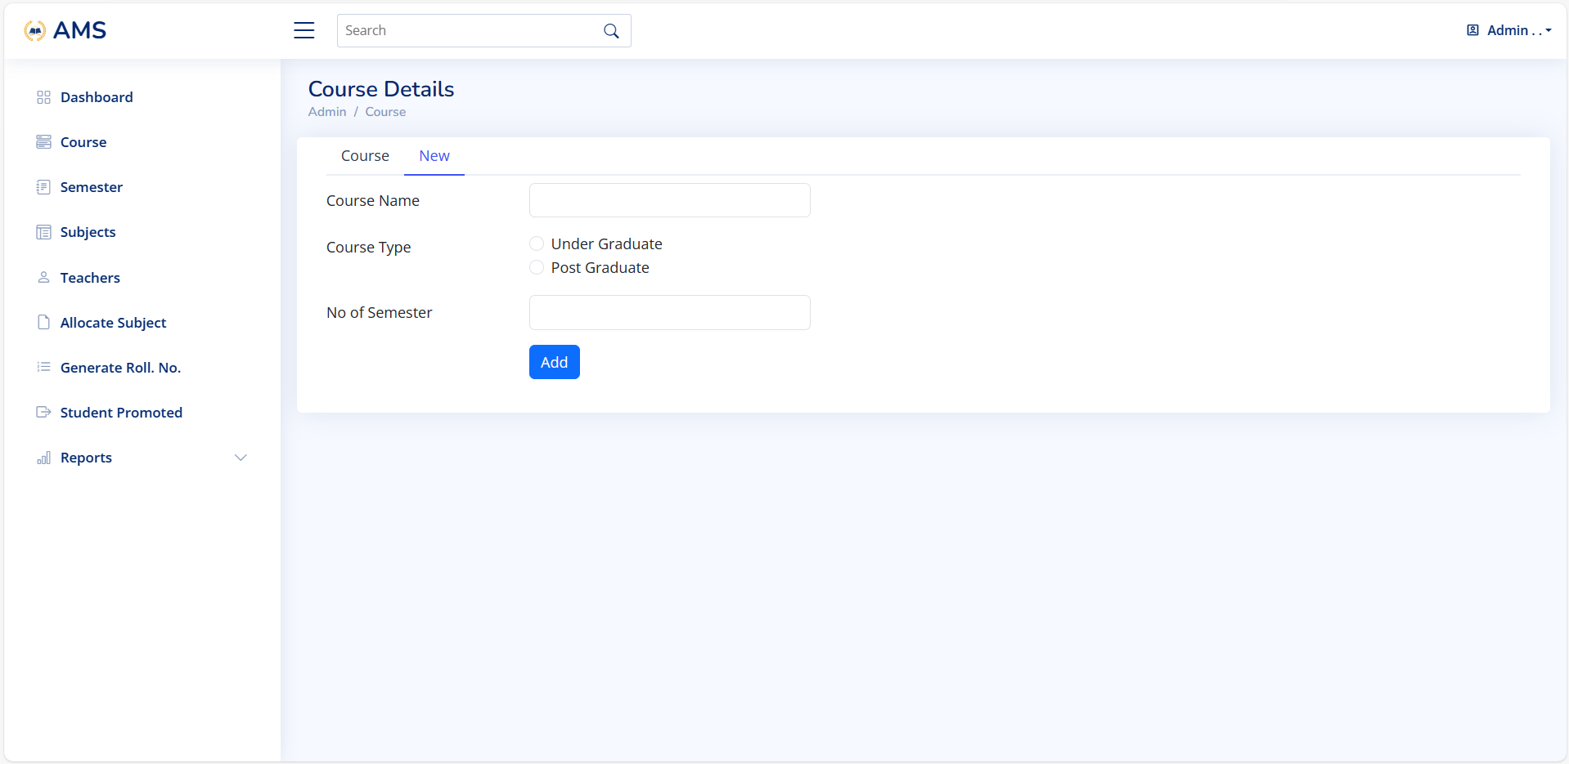

Slide 43
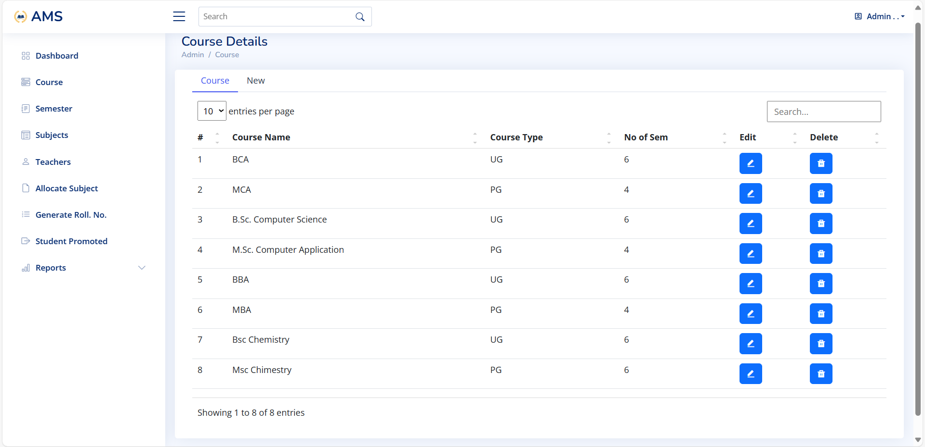

Slide 44
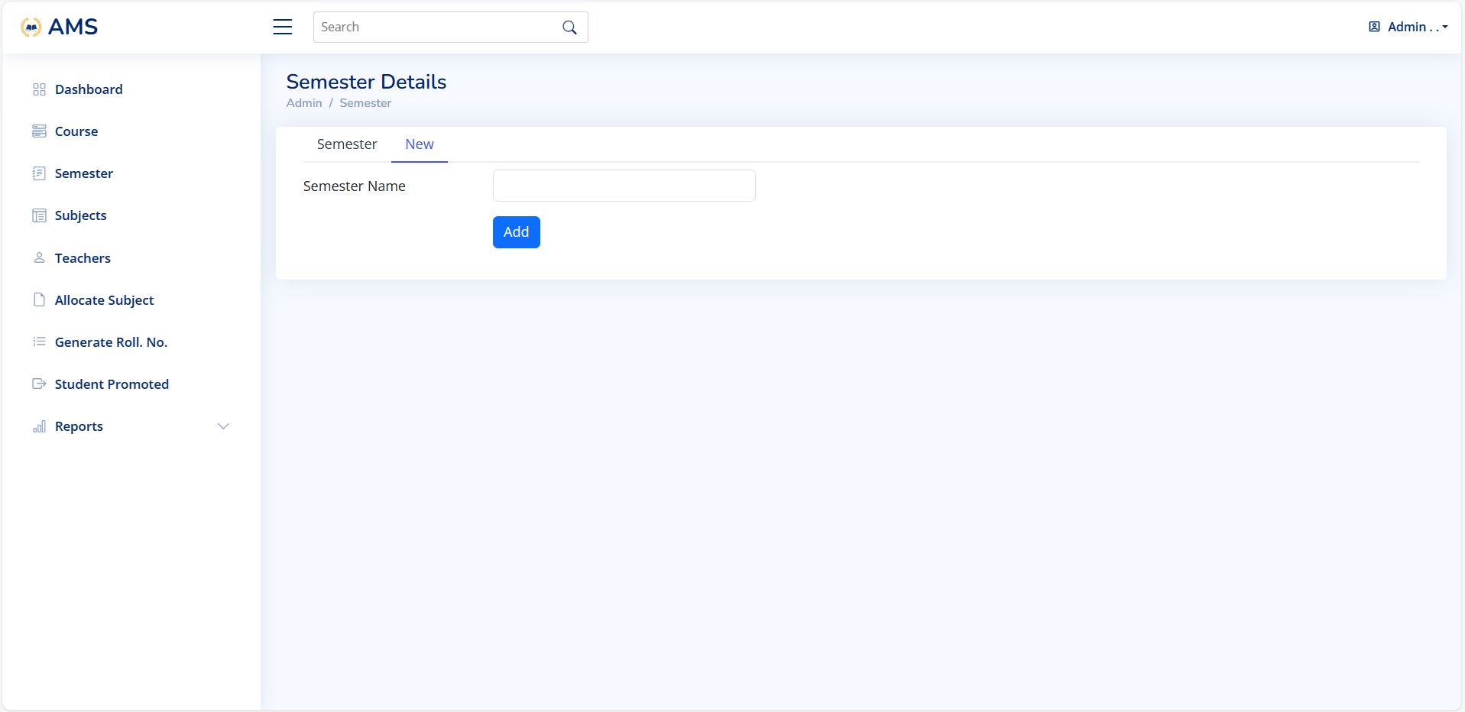

Slide 45
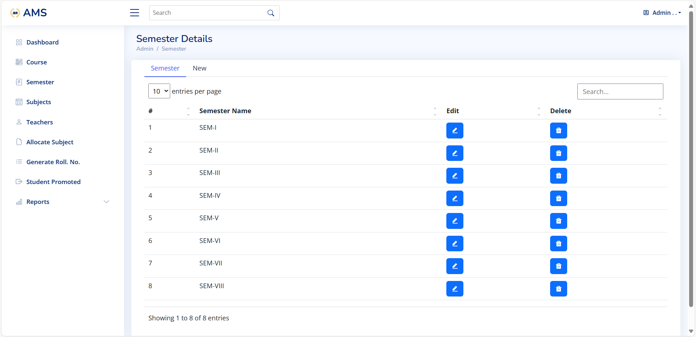

Slide 46
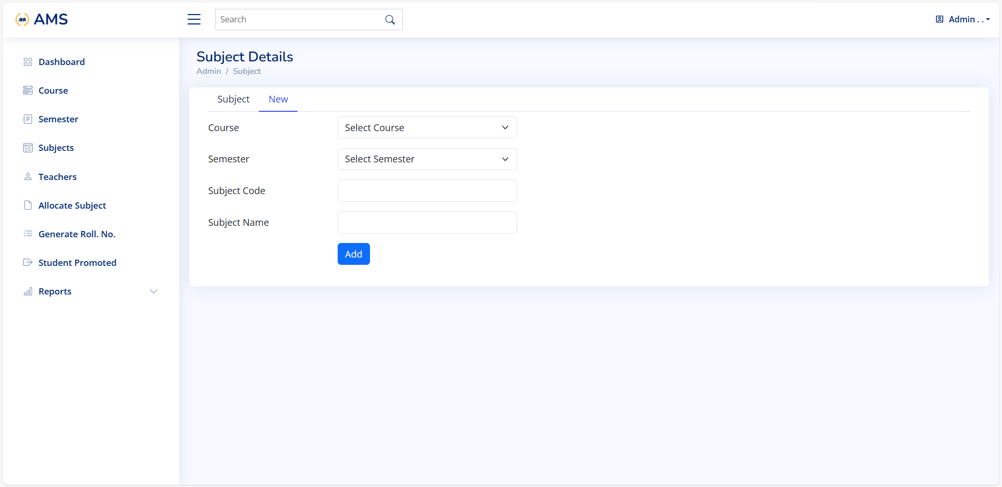

Slide 47
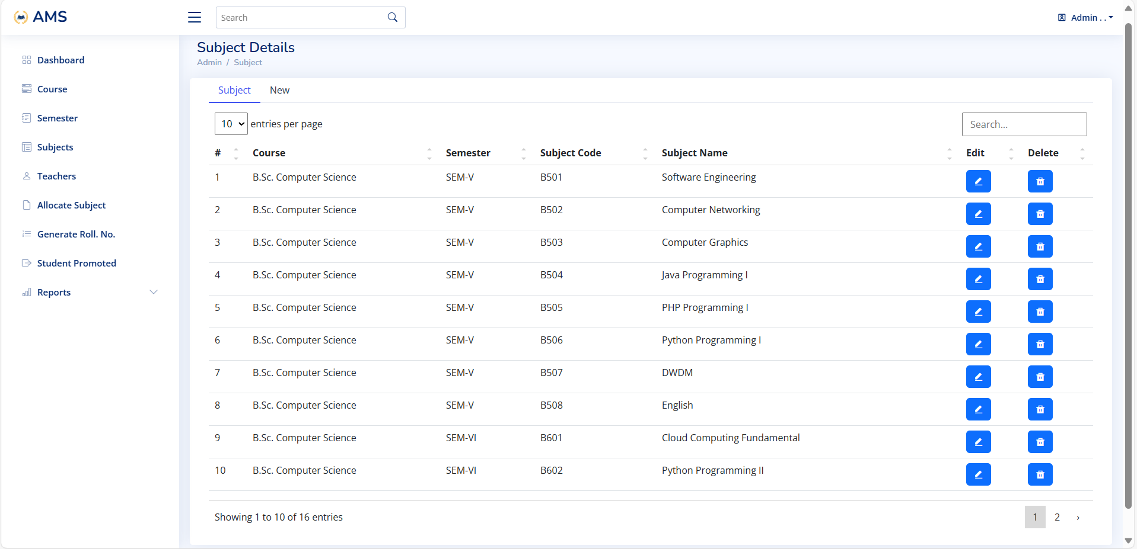

Slide 48
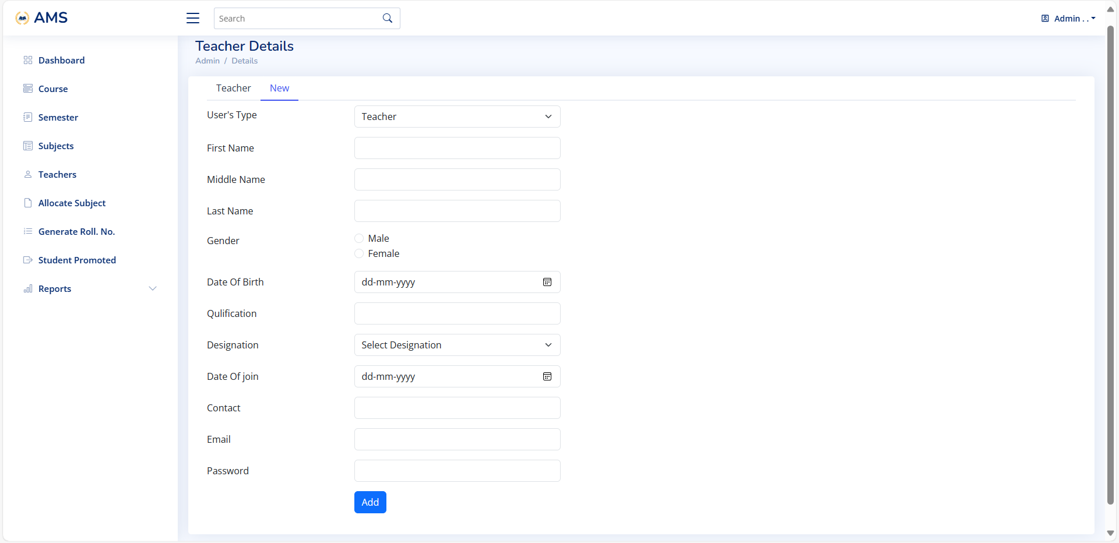

Slide 49
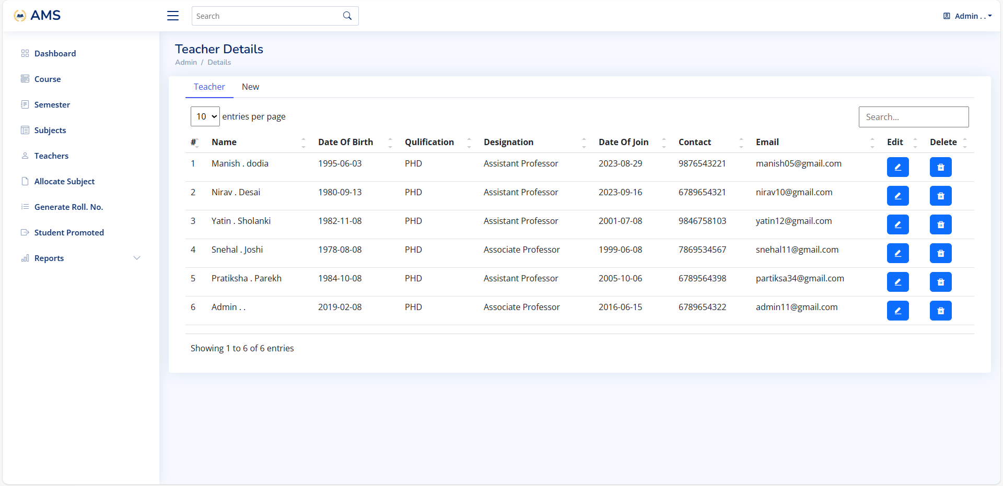

Slide 50
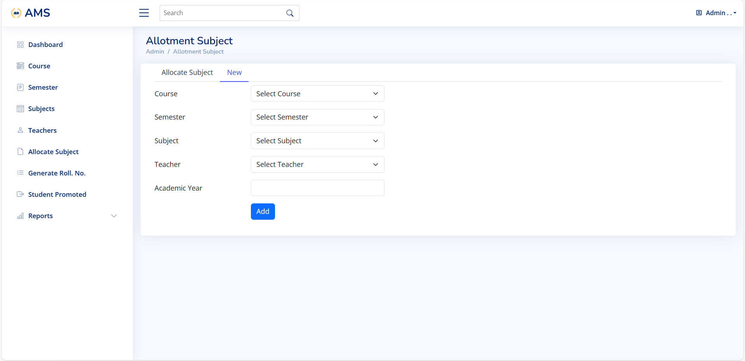

Slide 51
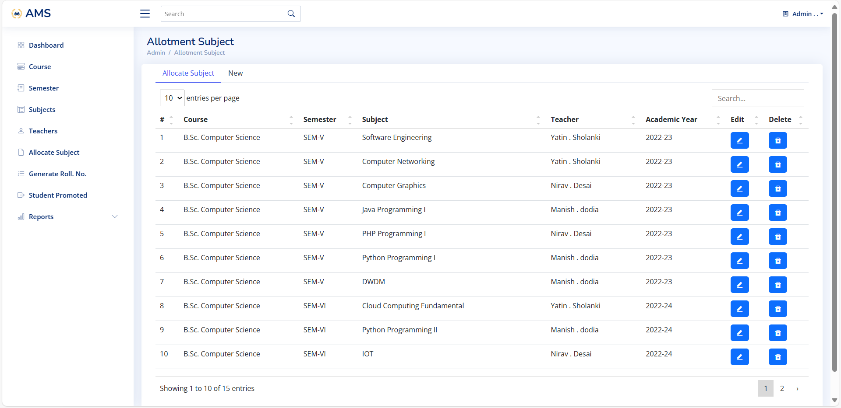

Slide 52
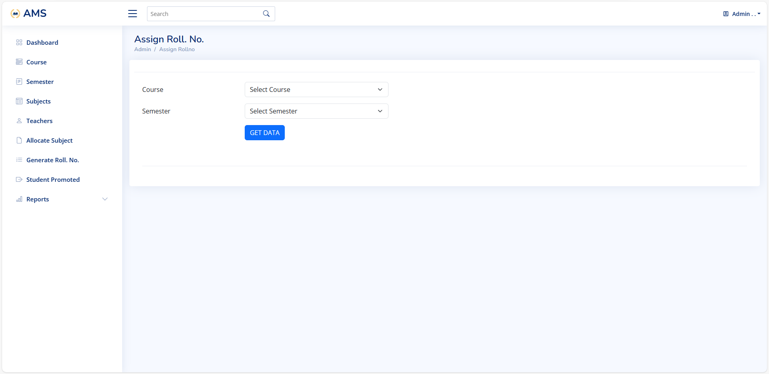

Slide 53
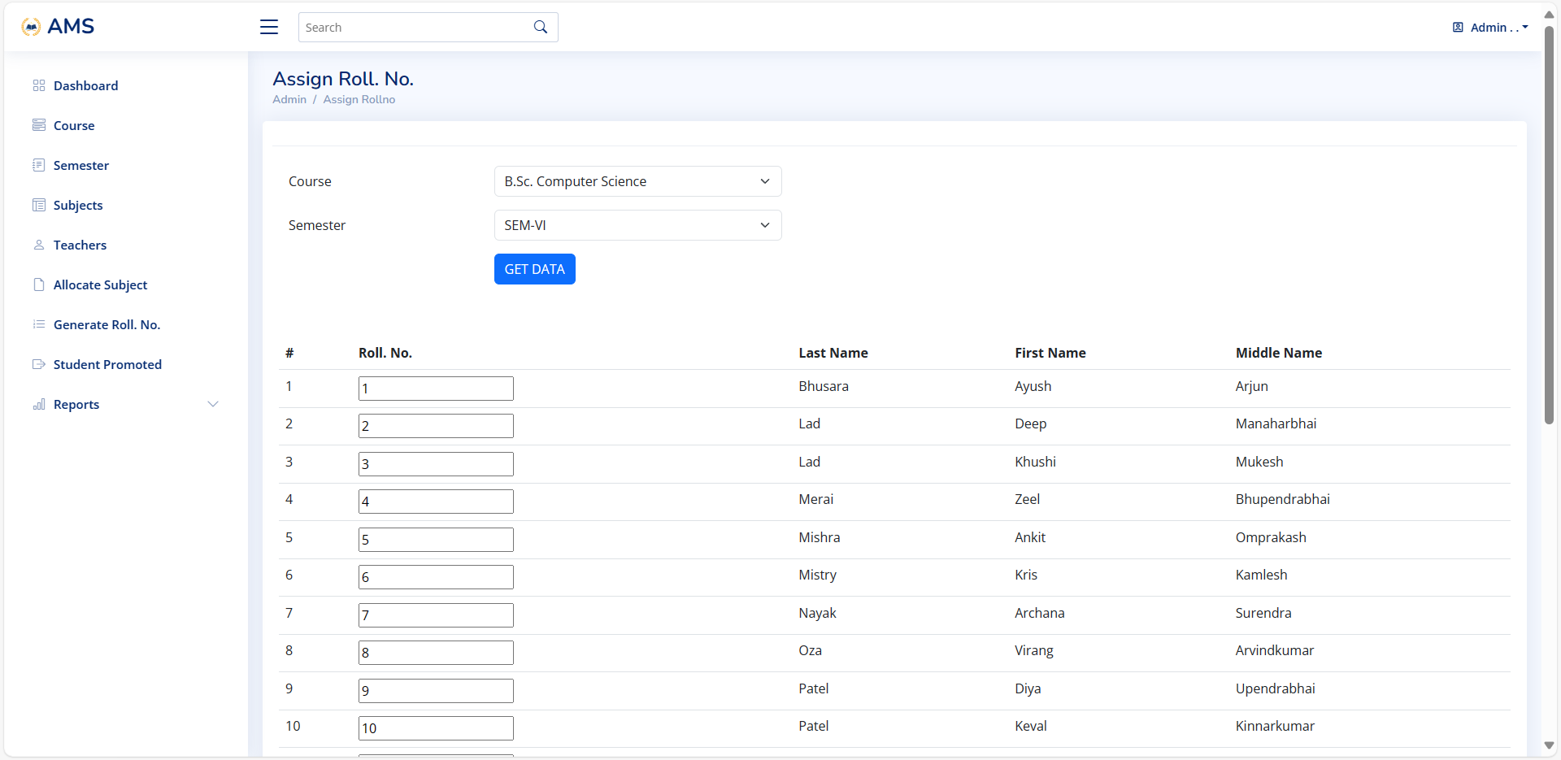

Slide 54
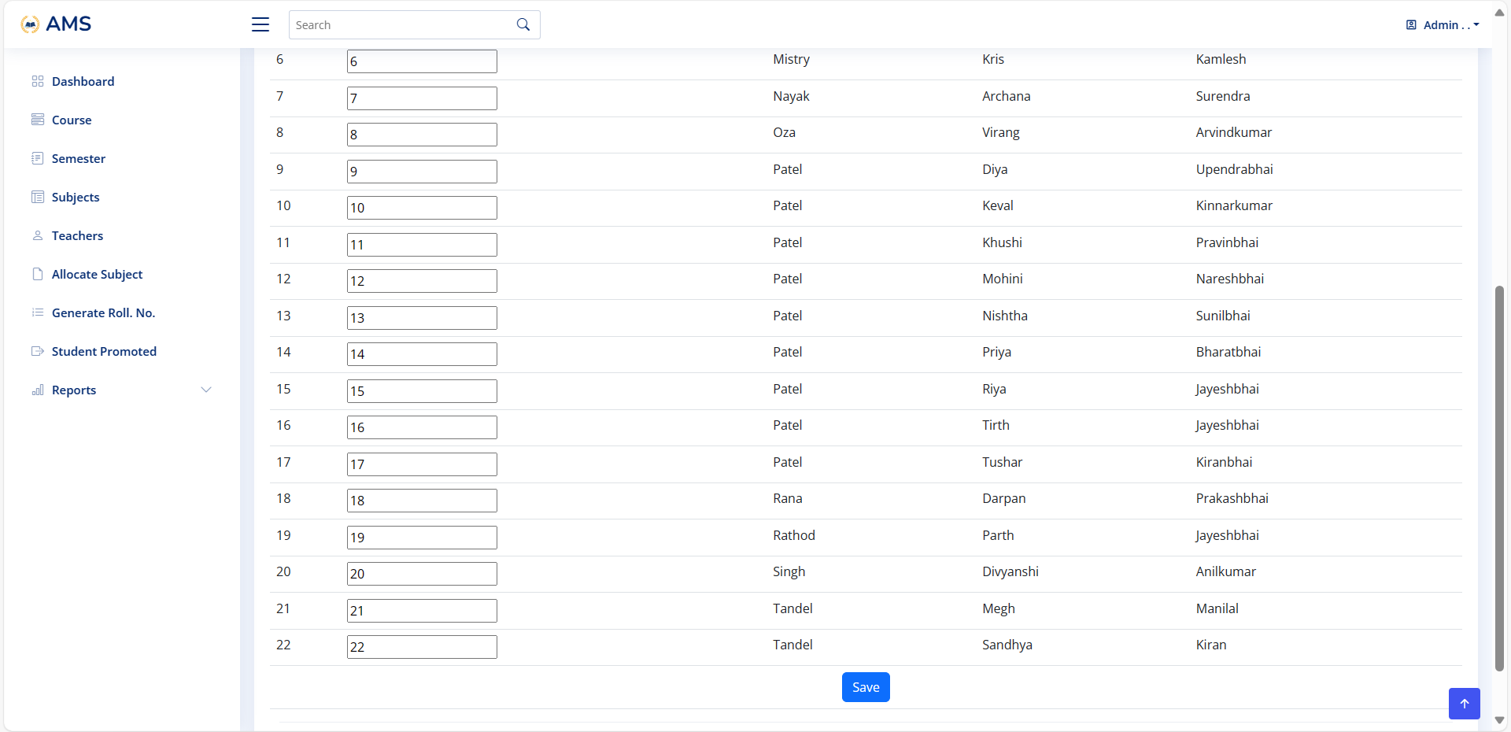

Slide 55
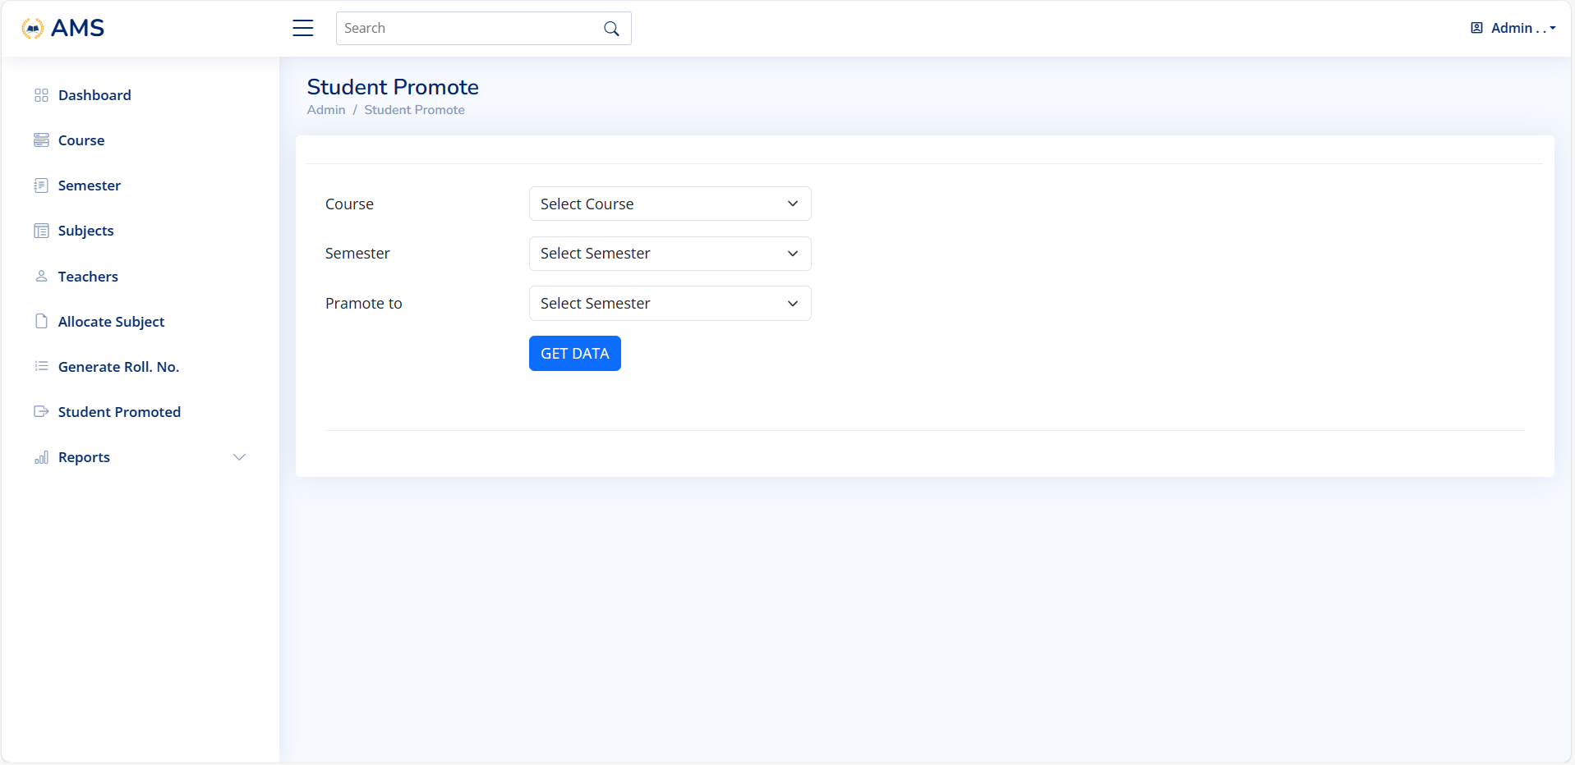

Slide 56
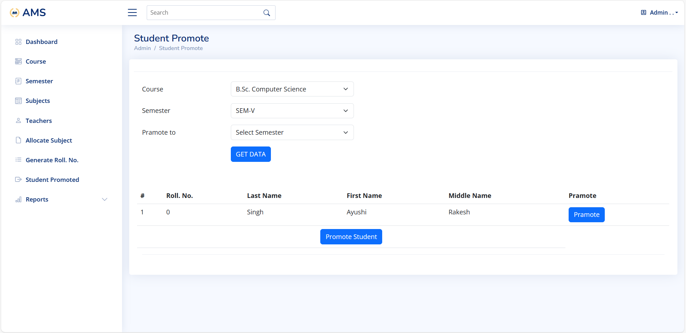

Slide 57
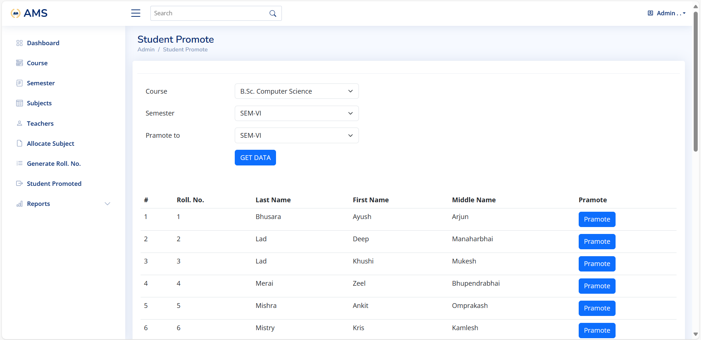

Slide 58
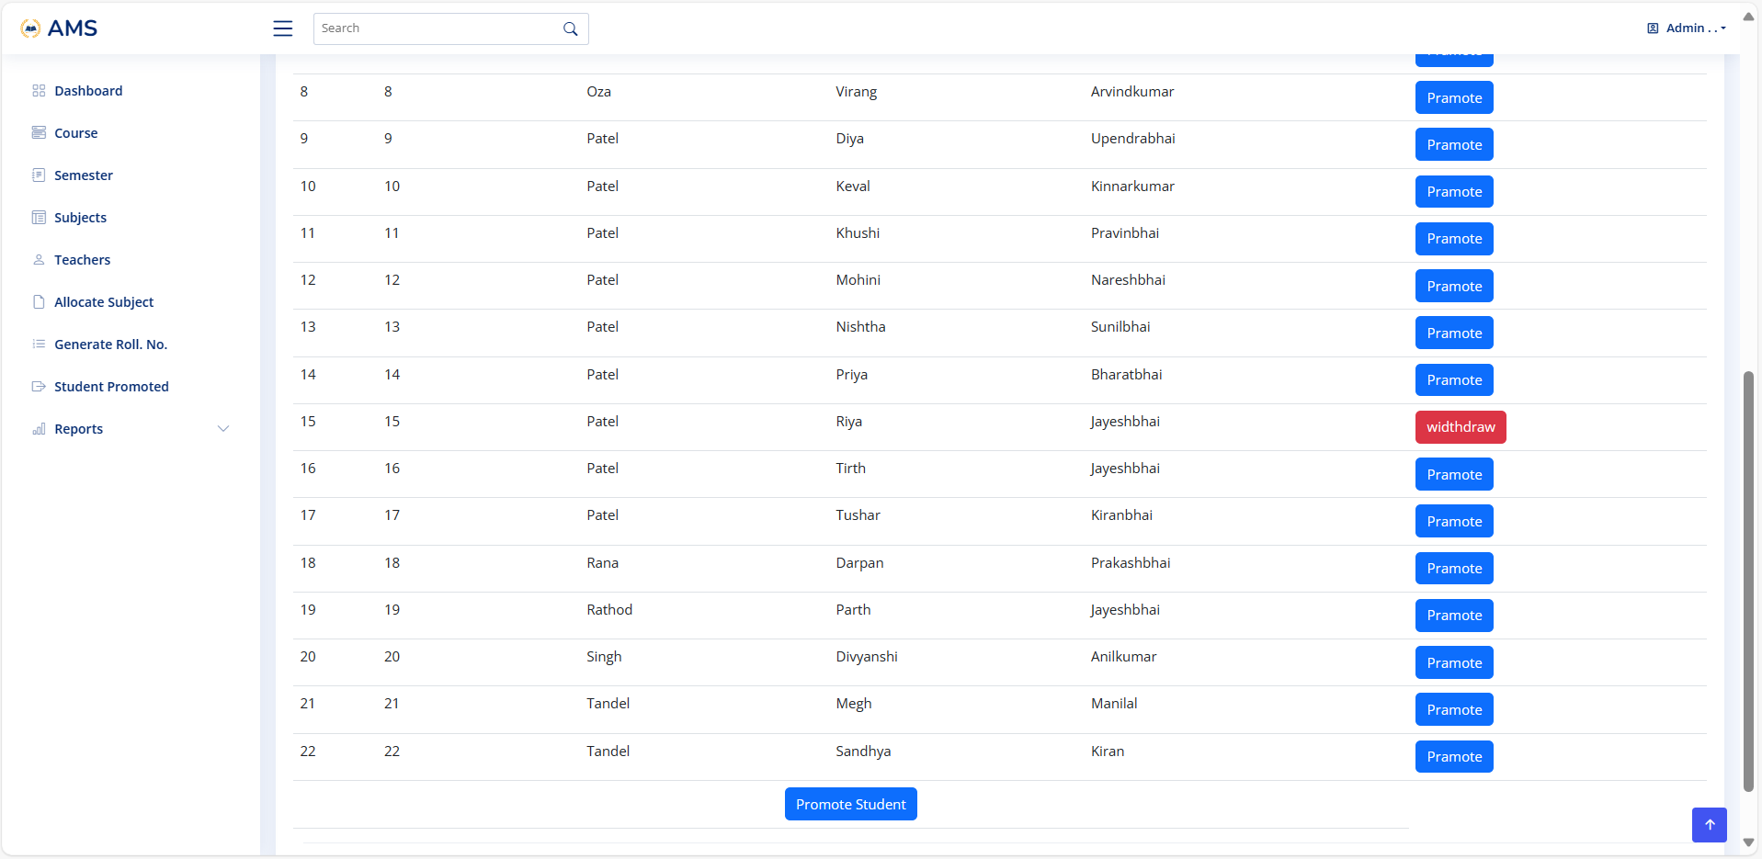

Slide 59
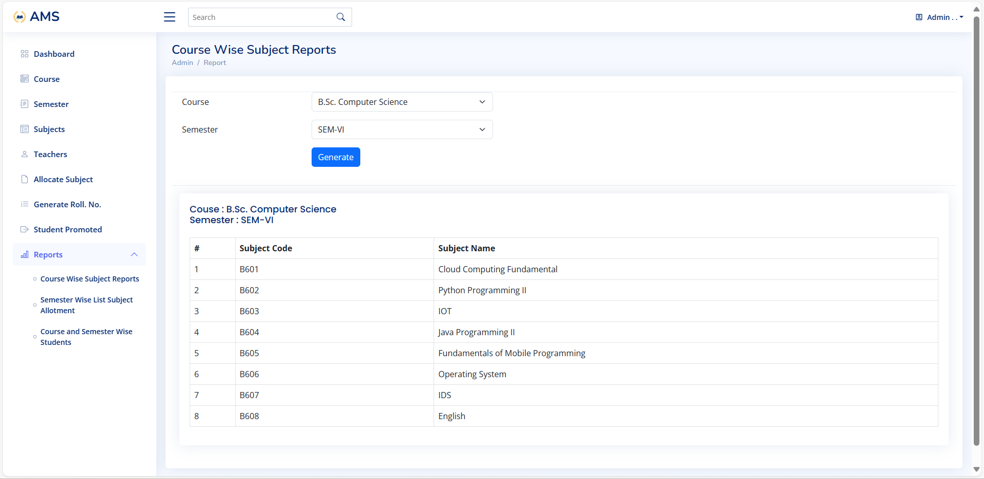

Slide 60
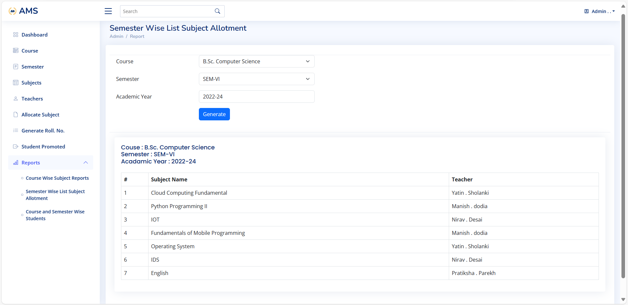

Slide 61
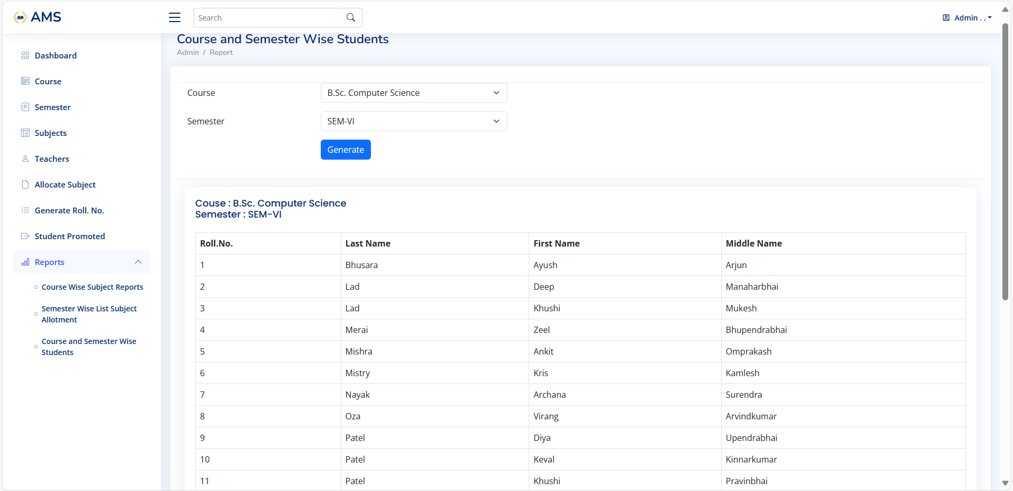

Slide 62
Teacher Side

Slide 63


Slide 64
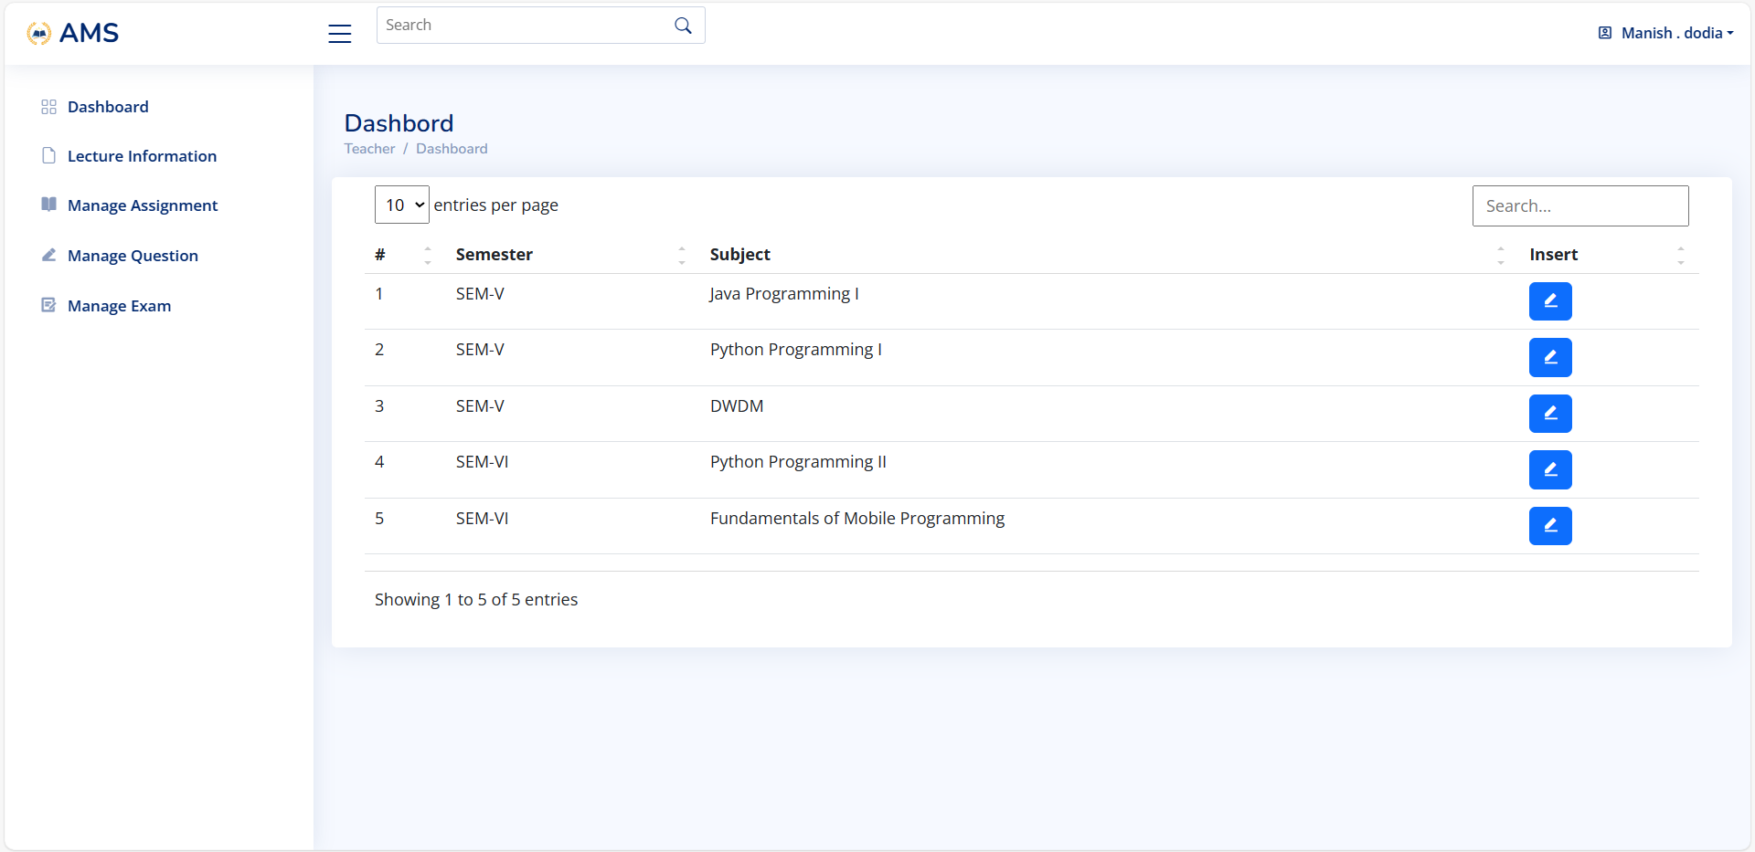

Slide 65
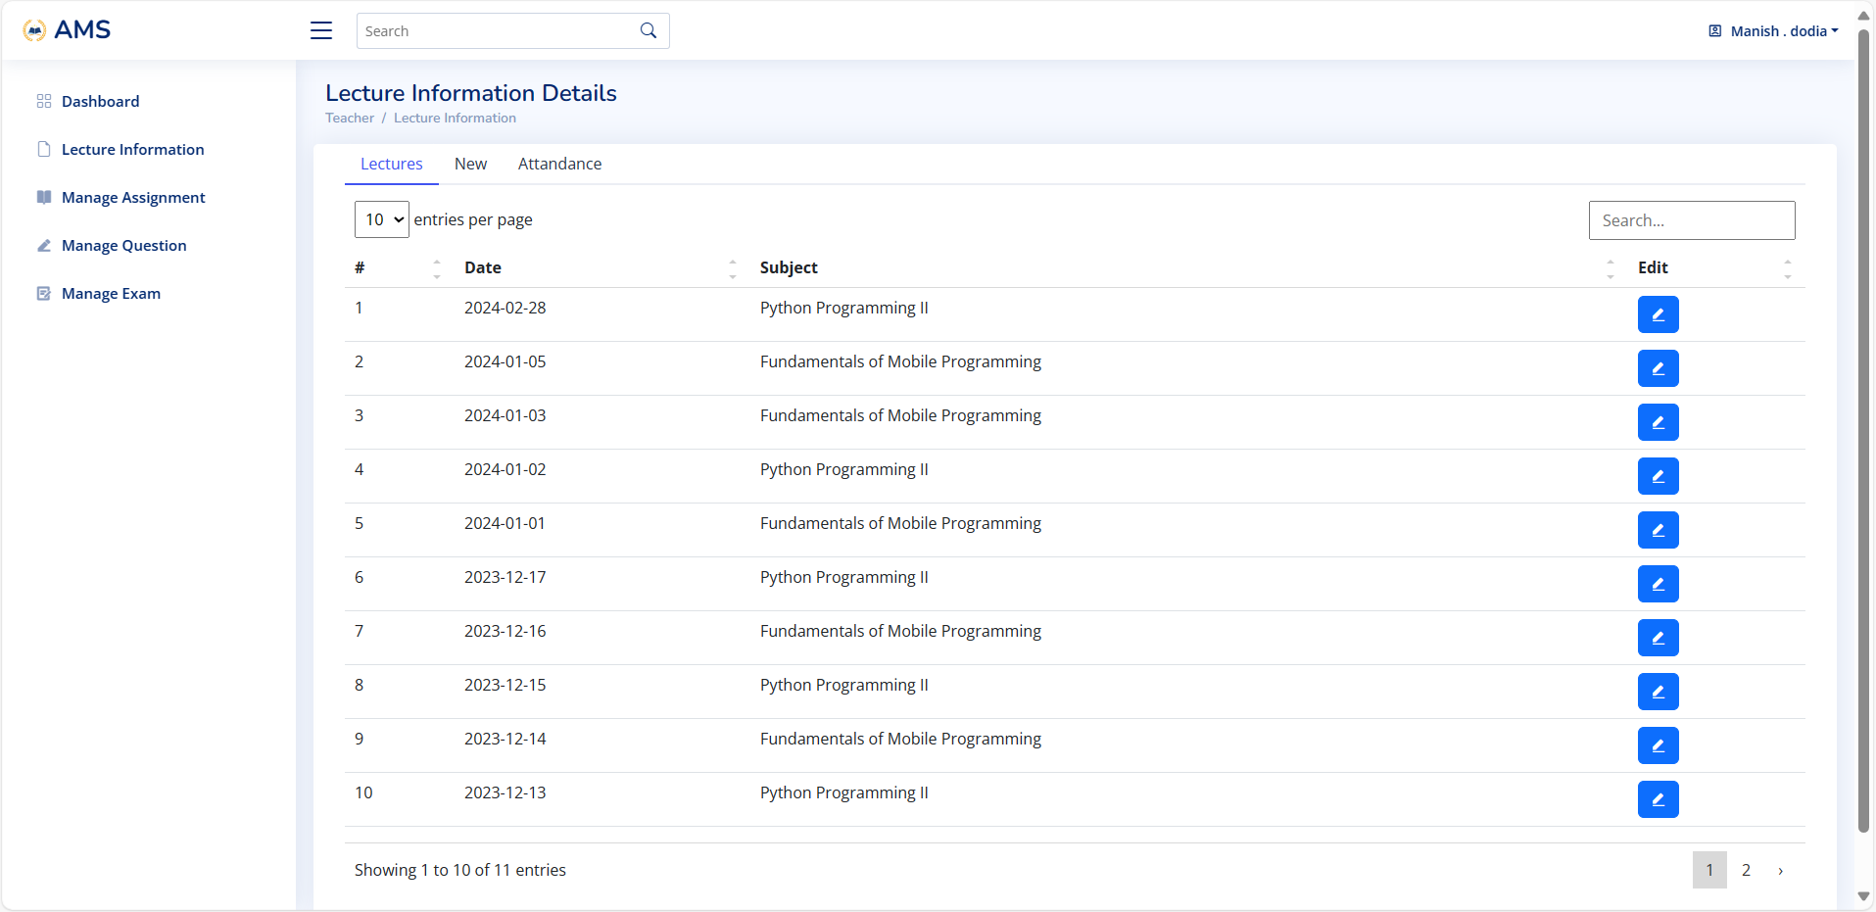

Slide 66
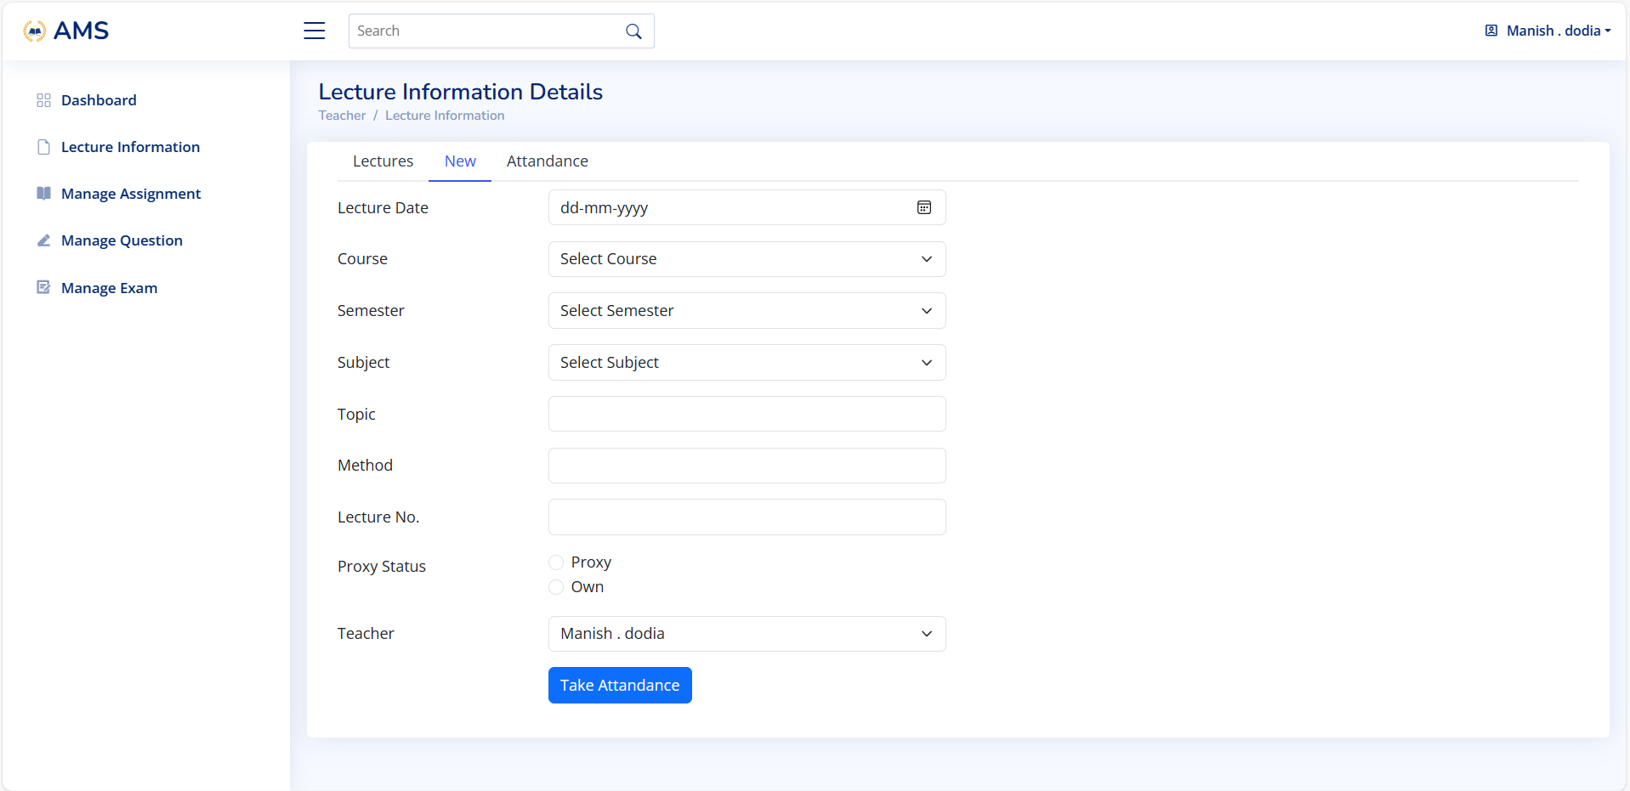

Slide 67
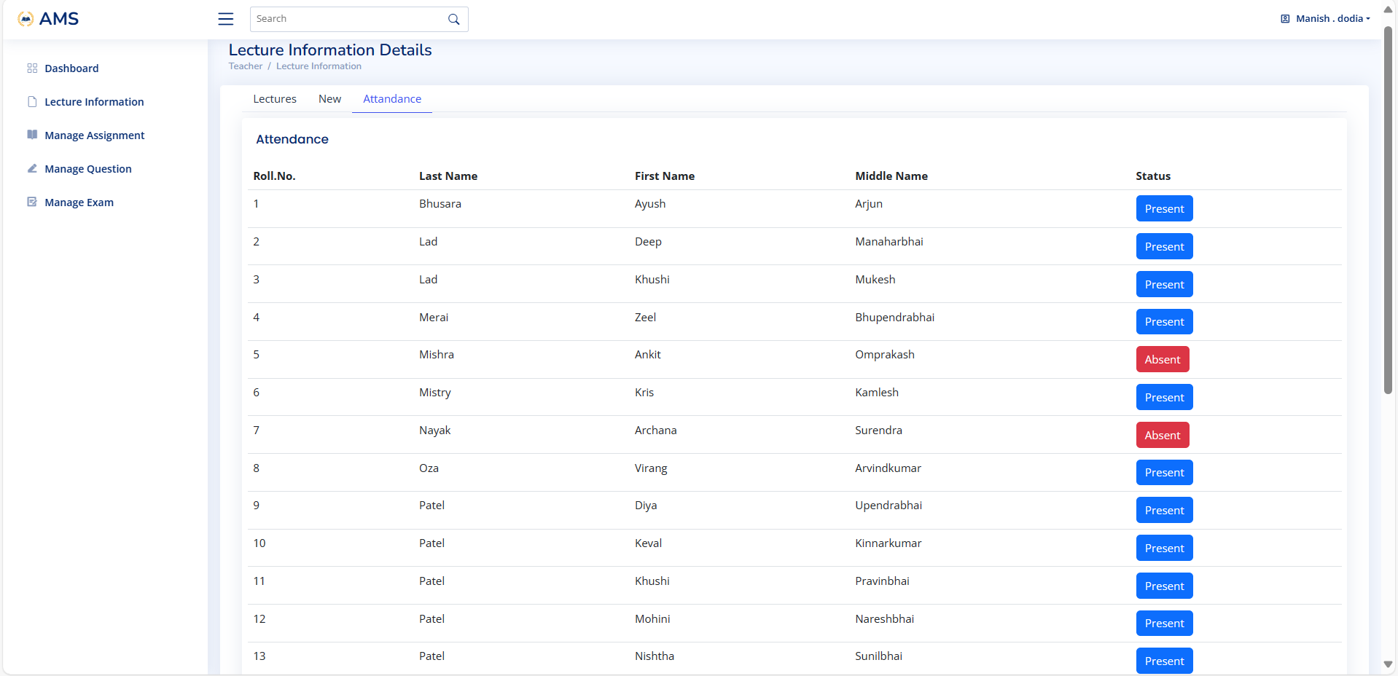

Slide 68
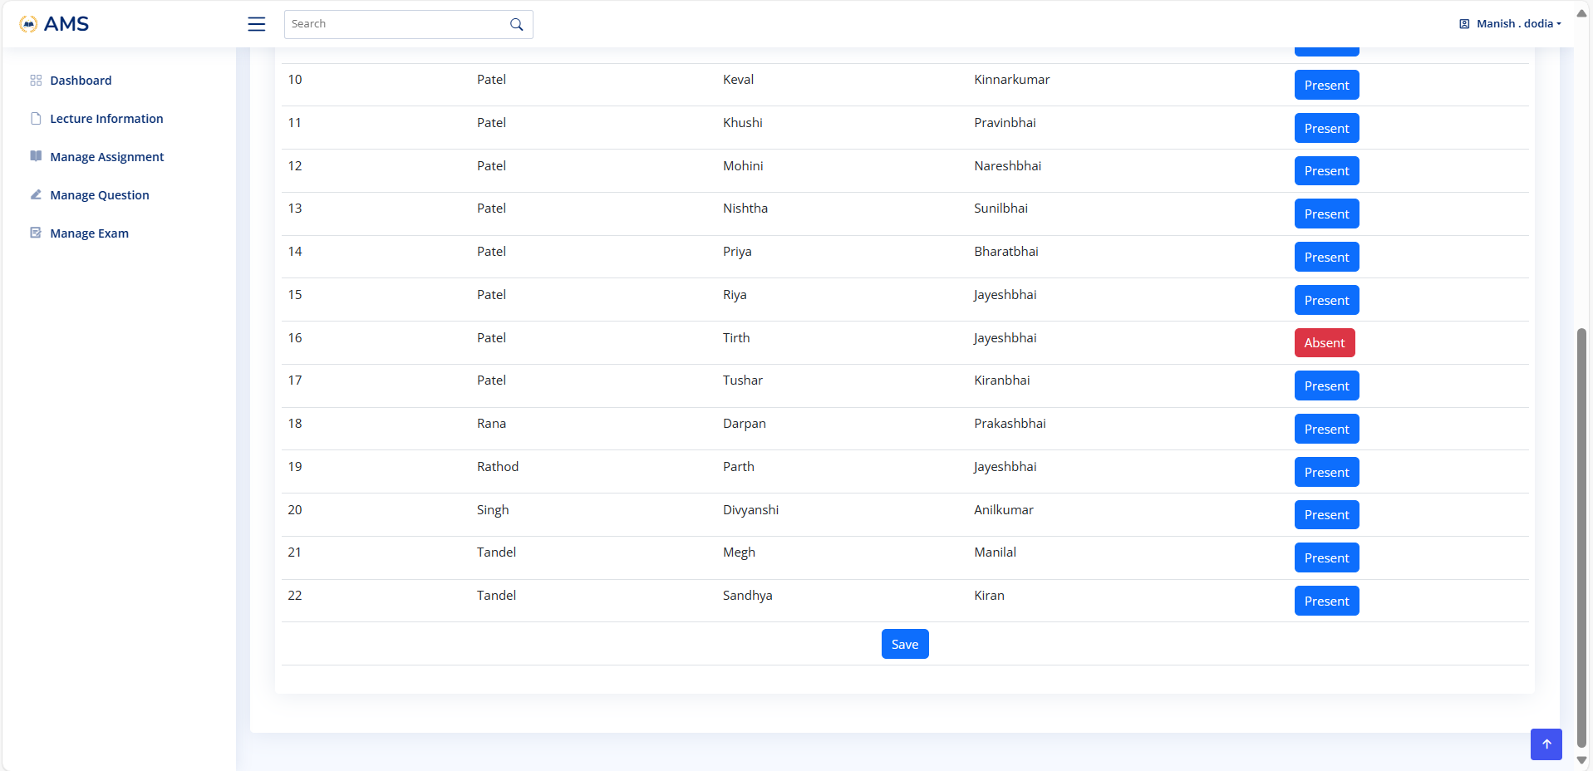

Slide 69


Slide 70
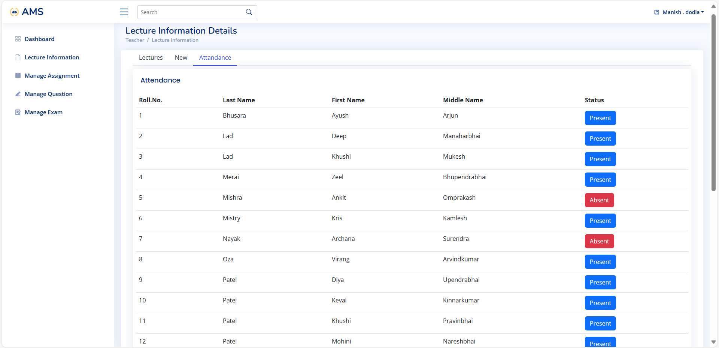

Slide 71
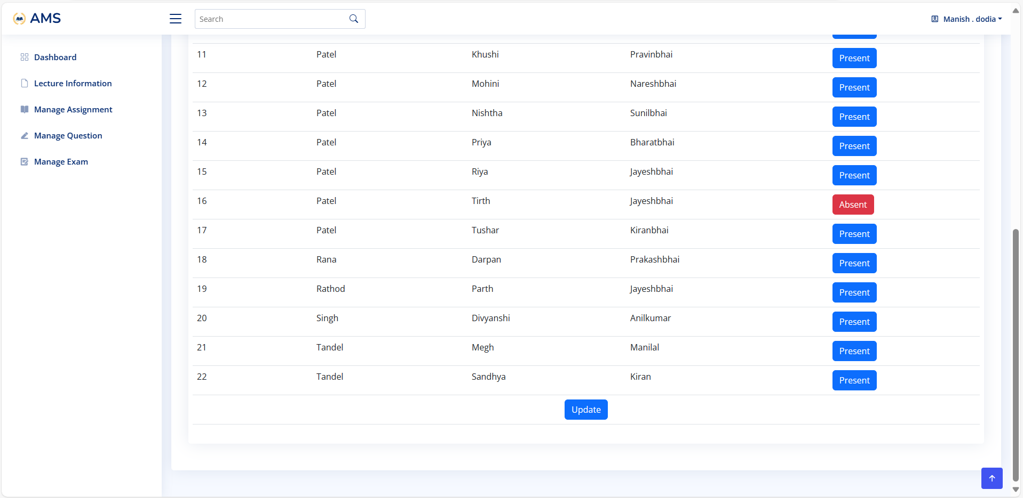

Slide 72
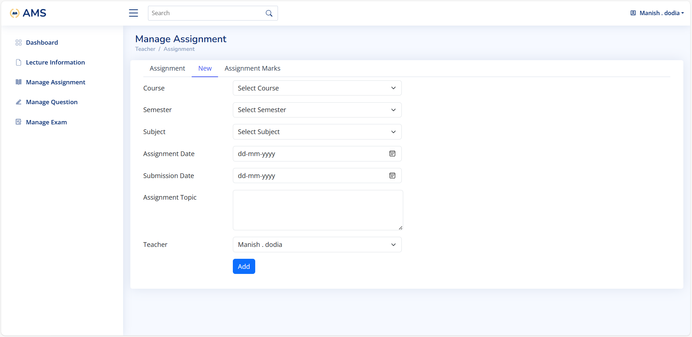

Slide 73
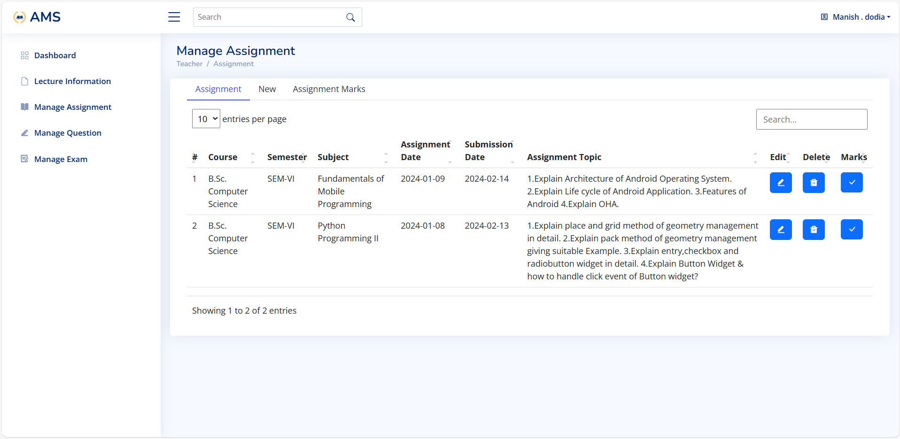

Slide 74
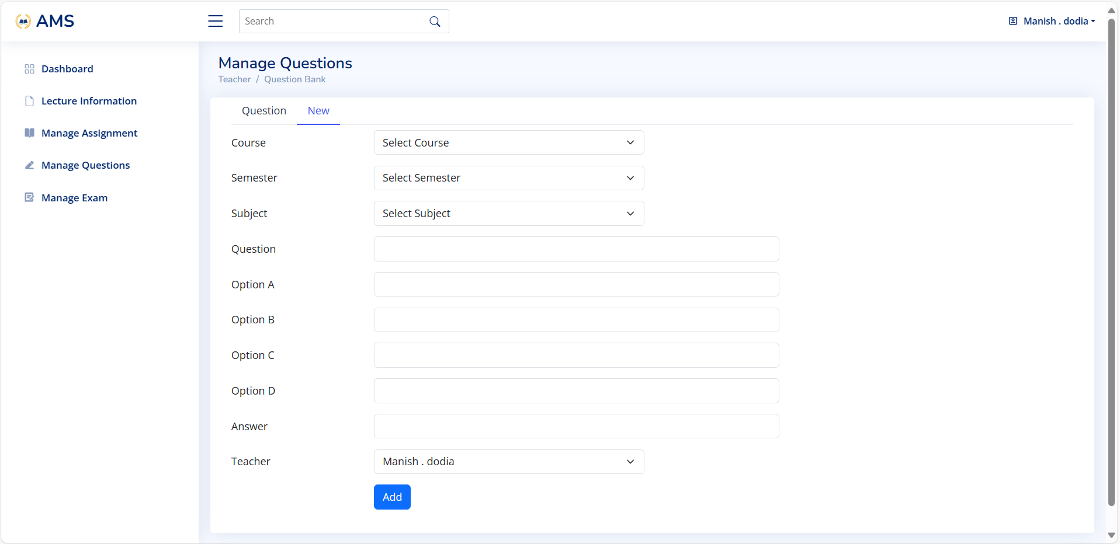

Slide 75
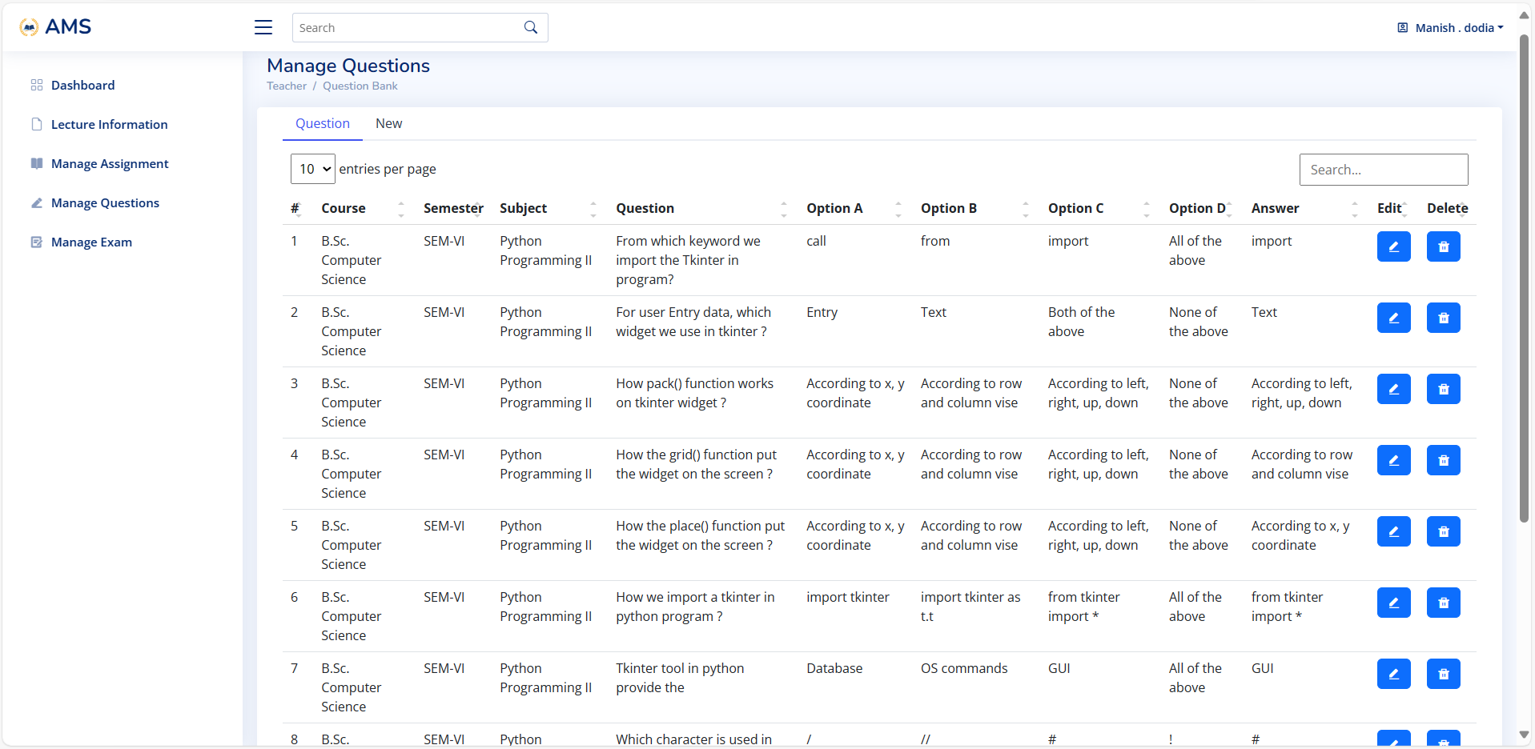

Slide 76
Student Side

Slide 77
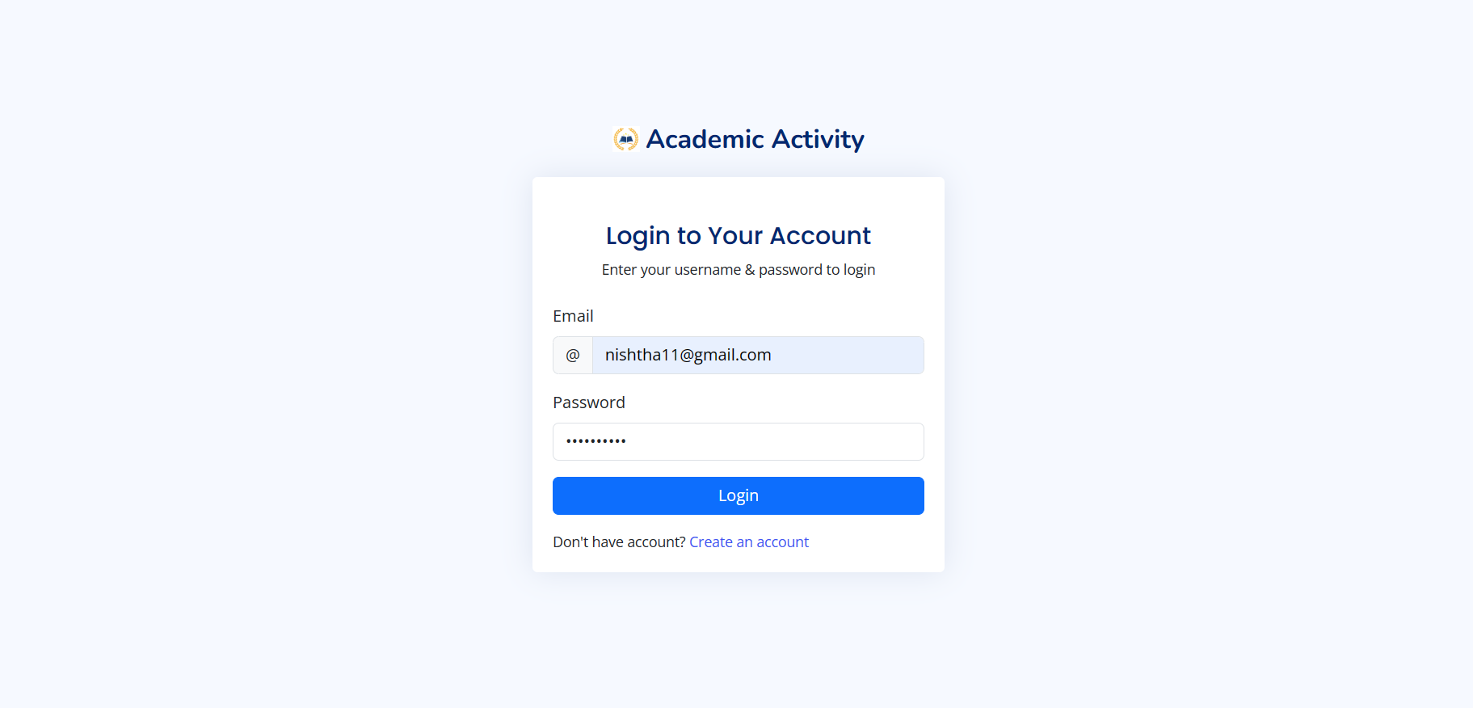

Slide 78
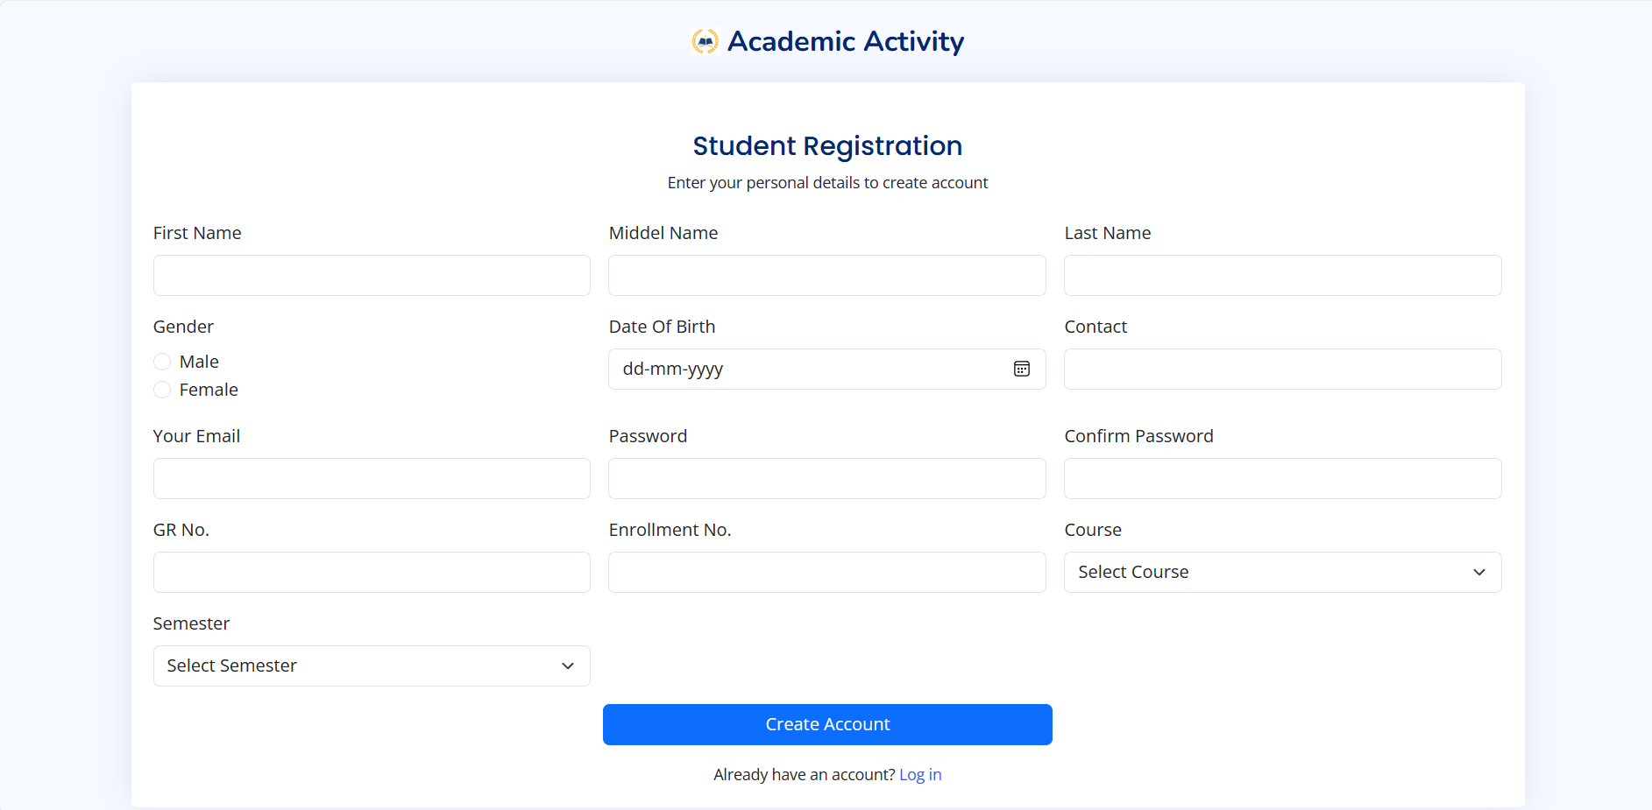

Slide 79
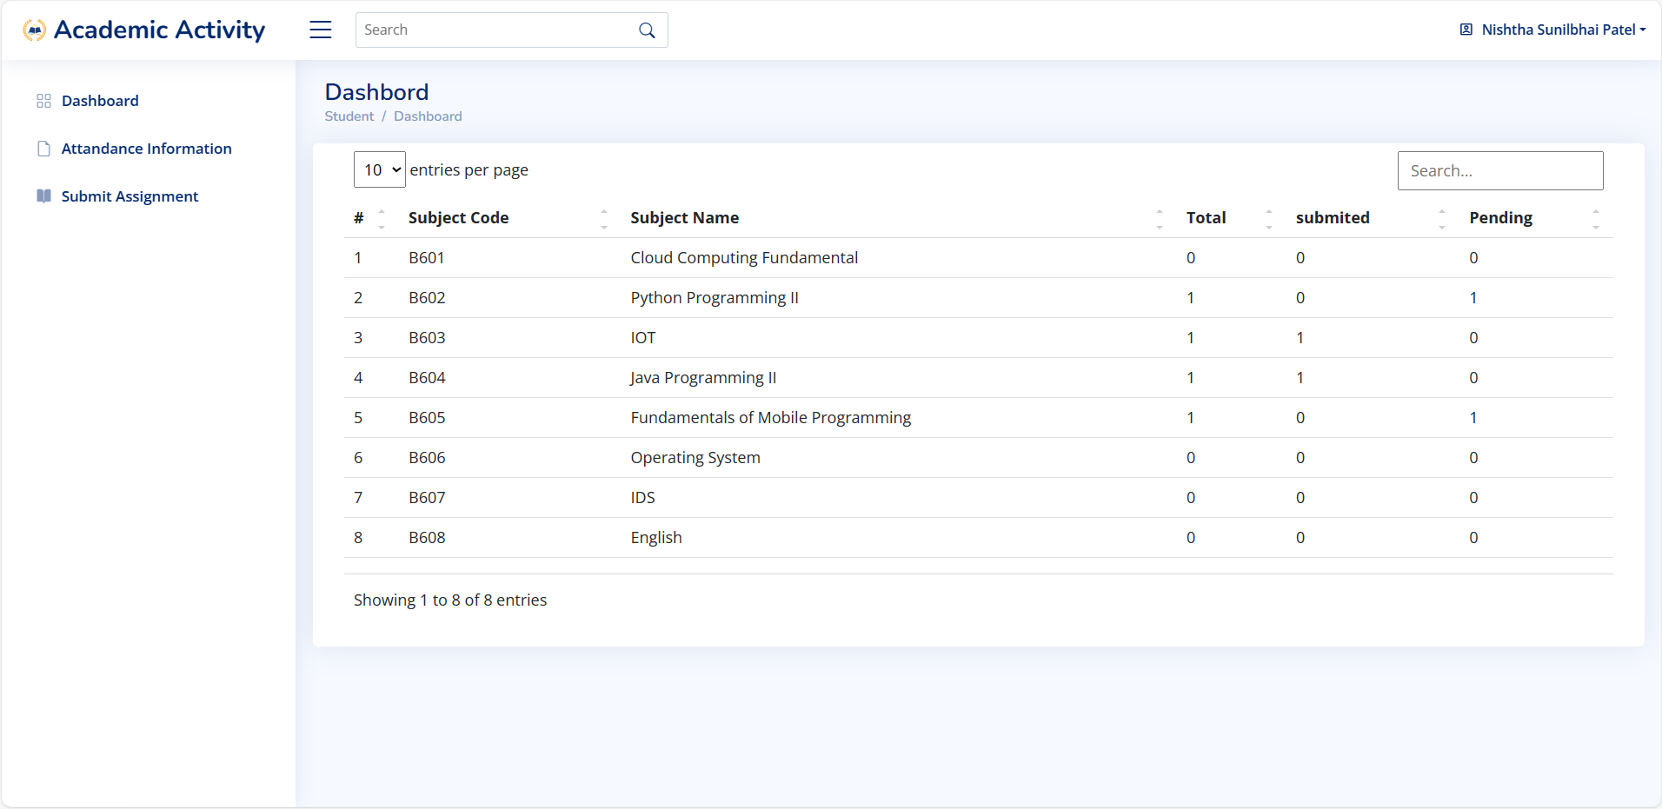

Slide 80
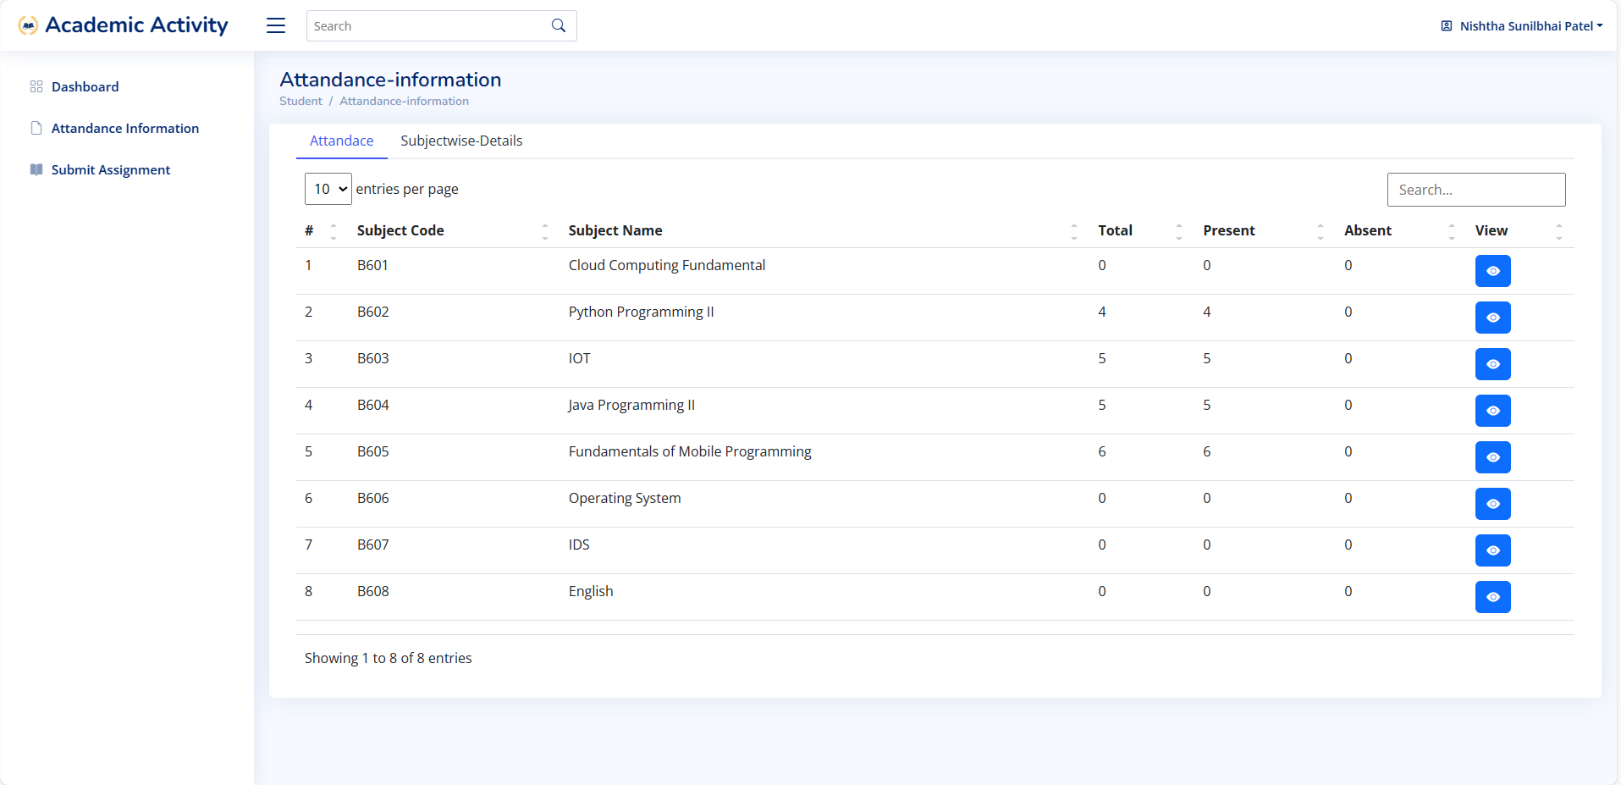

Slide 81
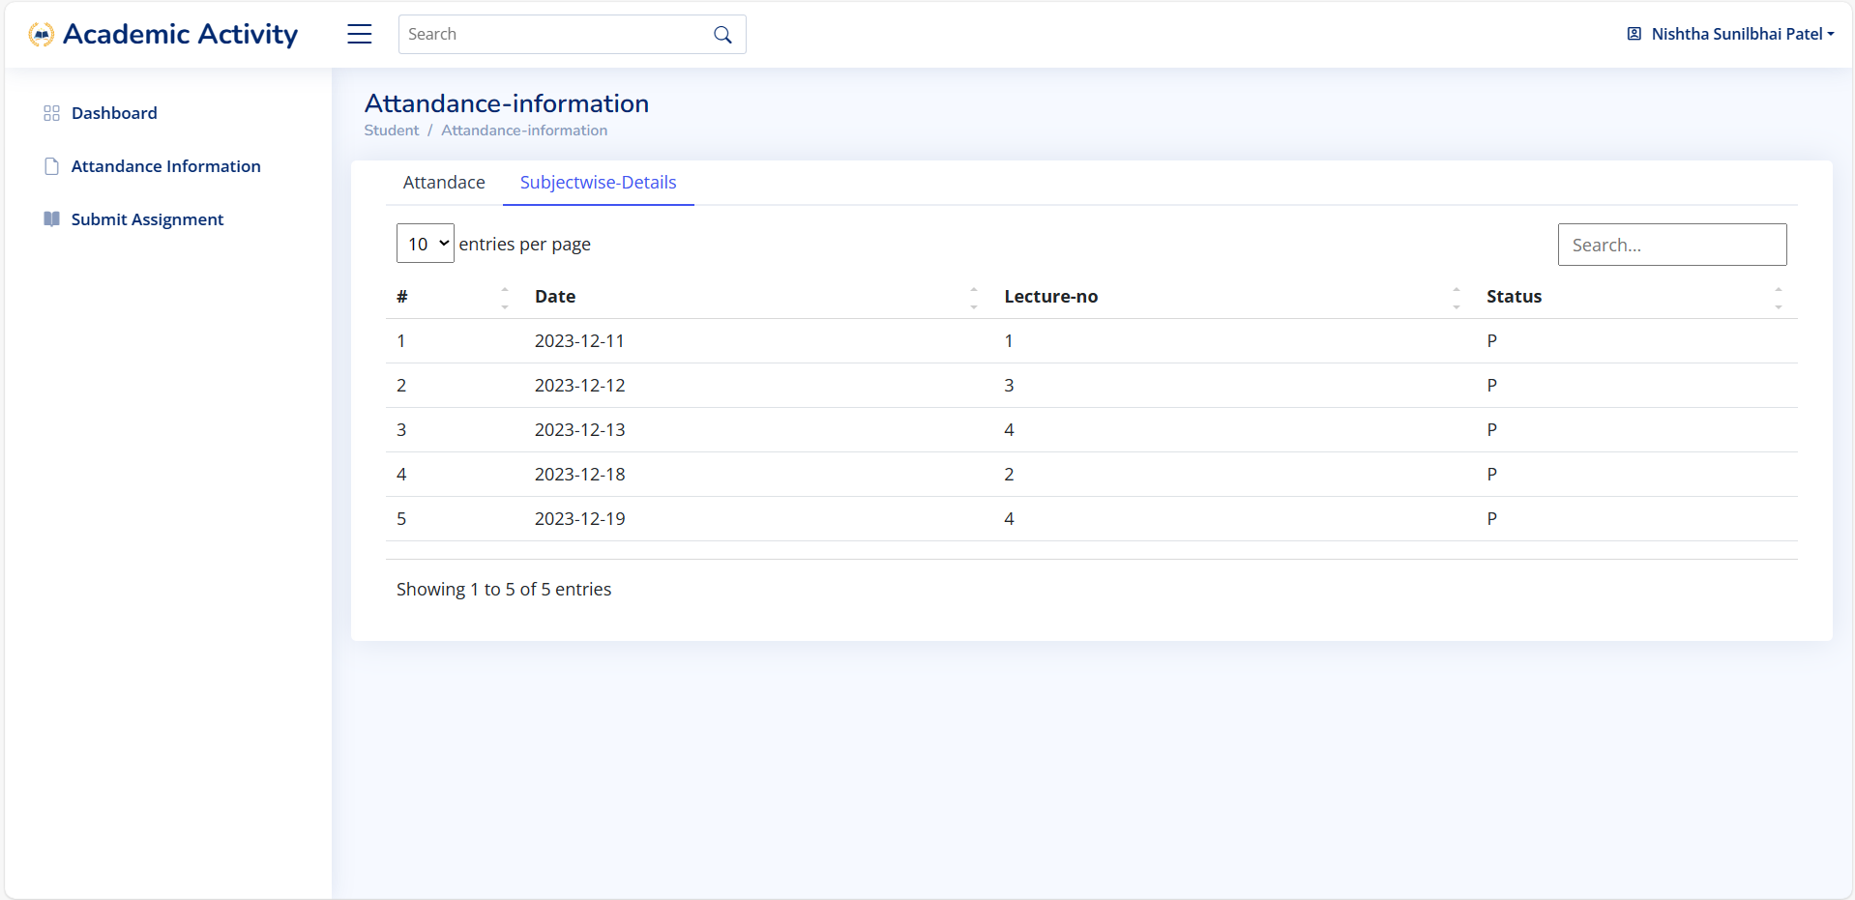

Slide 82
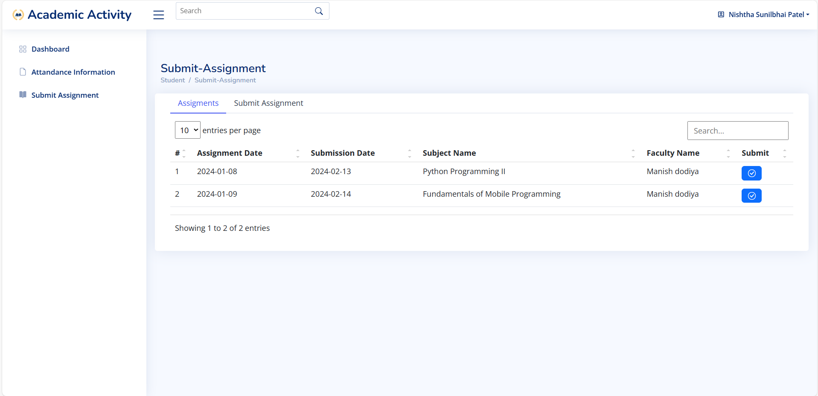

Slide 83
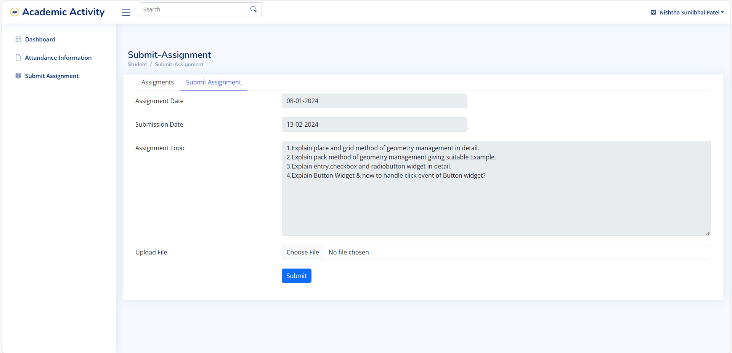

Slide 84
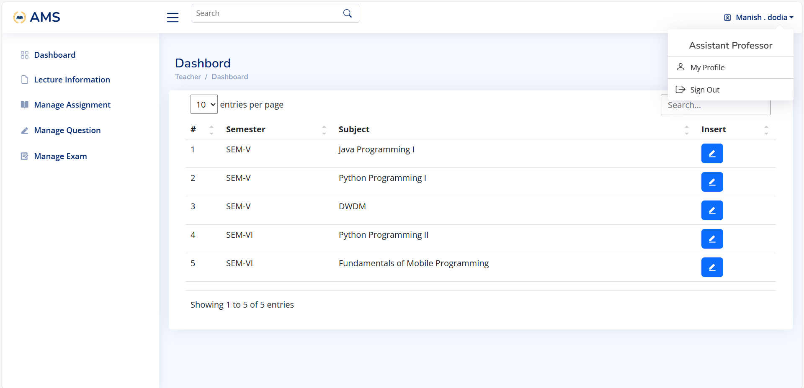

Slide 85
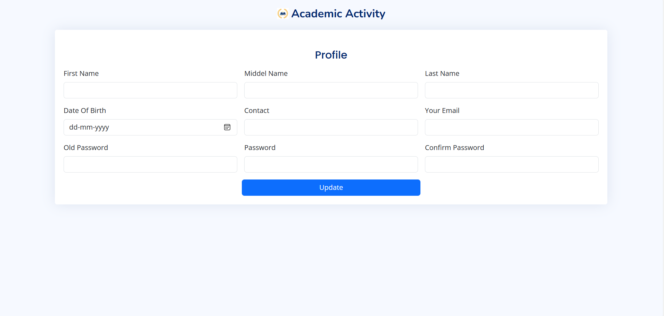

Slide 86
conclusion :-
This online website developed using HTML, PHP and MySQL fulfills the basic objectives of the Academic activity tracking system for which it has been developed. The Academic activity tracking system has easy to maintain for attendance, assignment, questions bank, exam.

Slide 87
Thank You...!!

